Slide 1
Distant Herschel sources using a "color-deconfusion" technique
Xinwen Shu
CEA/Saclay
September 9, Rome

Slide 2
The importance of infrared bright galaxies (SMGs)
Trace a phase of the most intense stellar mass build-up in galaxies
Contribution to the cosmic star formation rate density
Progenitors of massive passive galaxies
Strong constraints on the model for galaxy evolution
And ……….

Slide 3
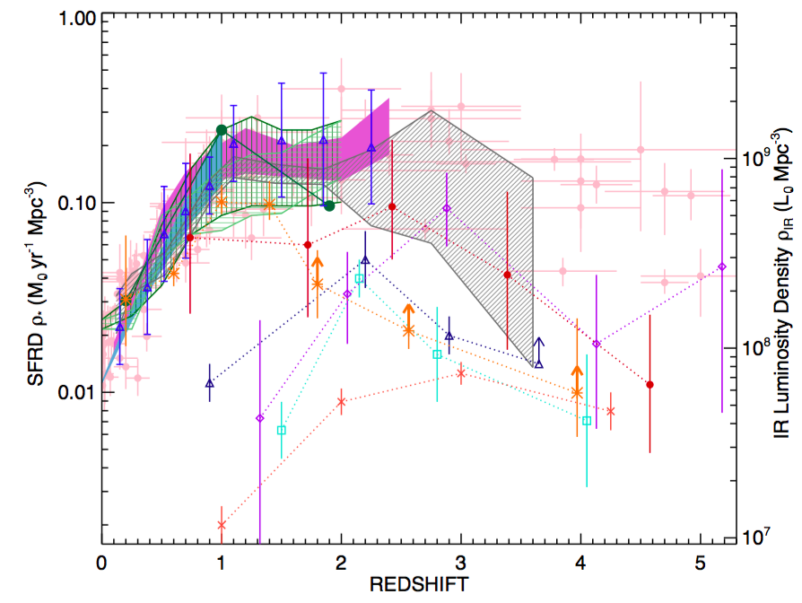
The importance of infrared bright galaxies (SMGs)
Casey et al. 2014

Slide 4
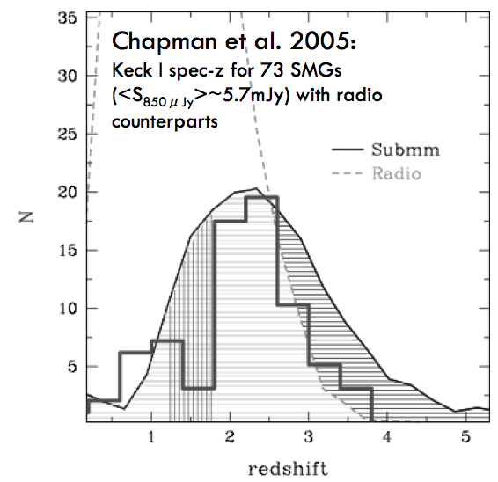
3.1 sigma

Slide 5
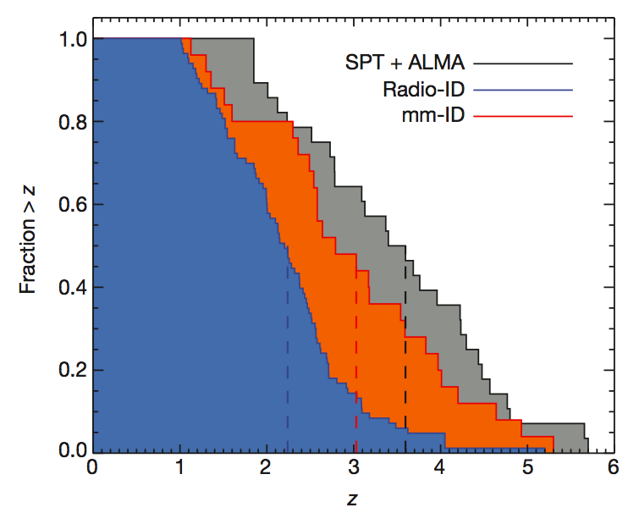
Z>3 SMGs emerging
Vieira et al. 2013

Slide 6
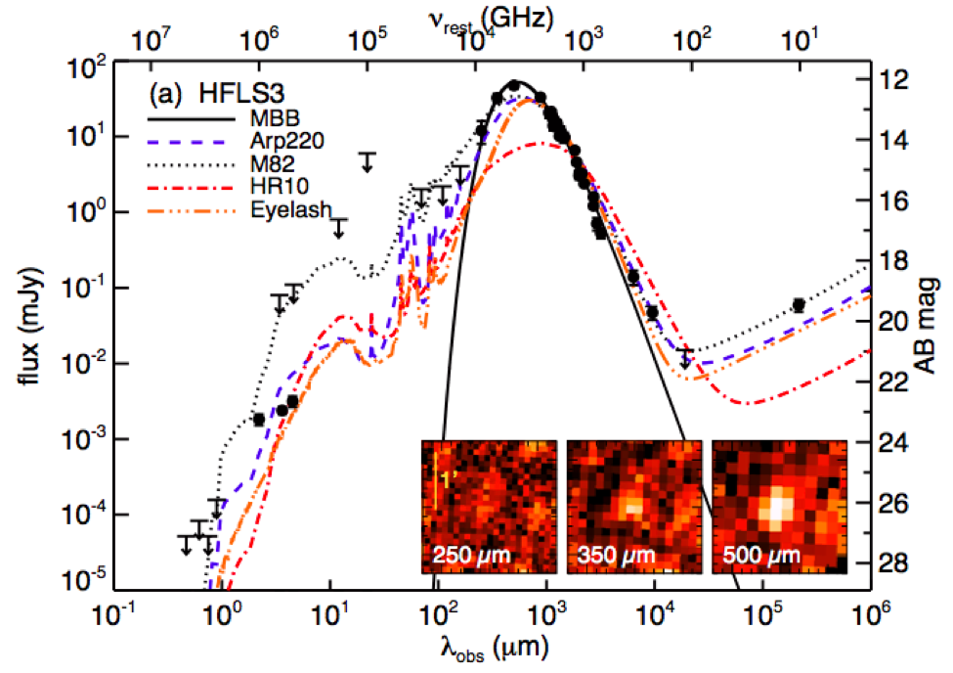
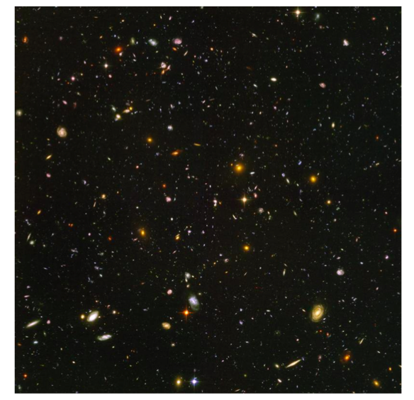
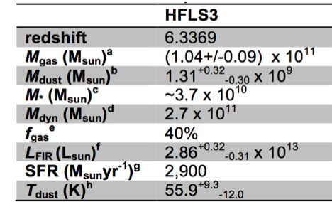
HFLS3: z=6.34
The most distant
dusty starburst found
with Herschel
Riechers et al. 2013
SFR ~4x all z=5.5-6.5
Galaxies in HUDF
^{Hubble Ultra Deep Field}

Slide 7
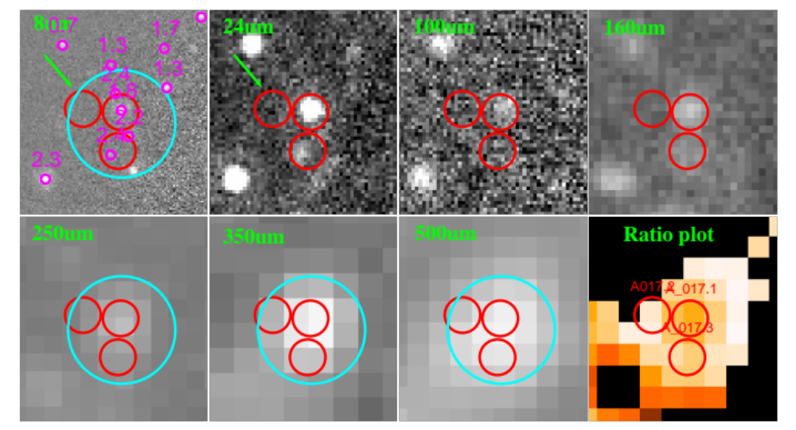
Herschel photometry catalog: using positions of
source >3sigma in the deep 24um image
Bias (1): against 24um non-detections

Slide 8
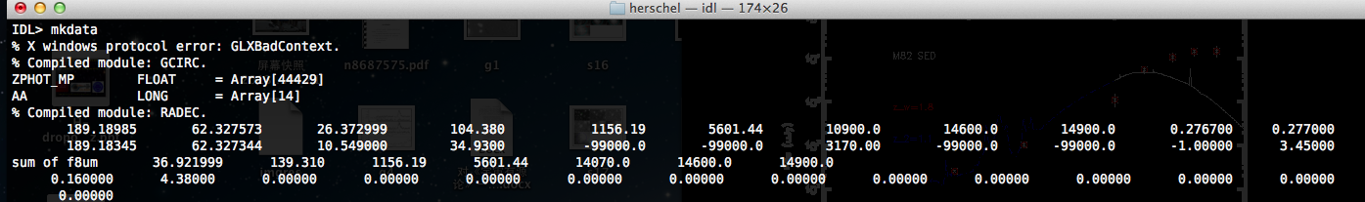
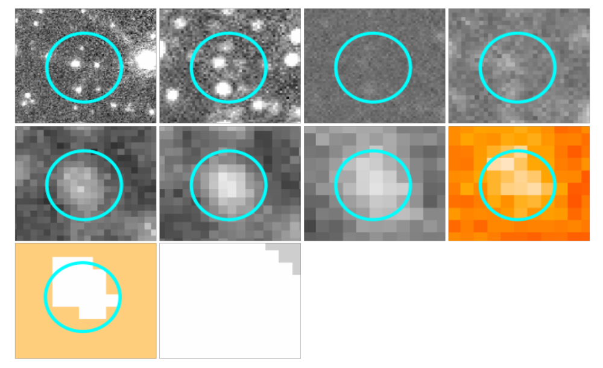
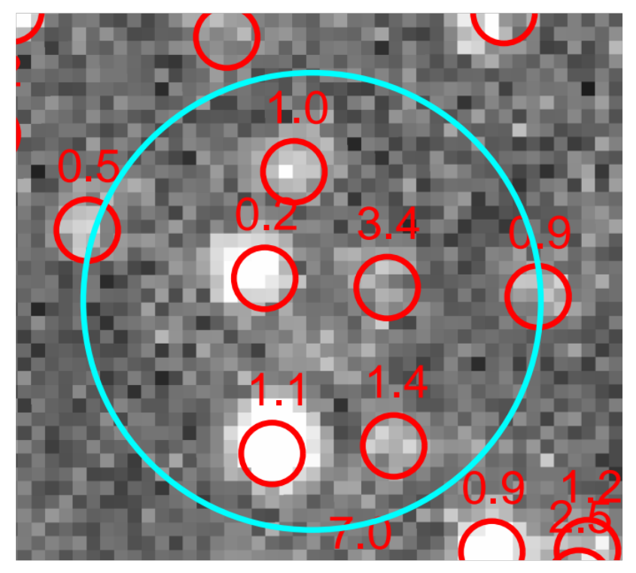
FWHM= 5.7” 6.7" 11" 18.1" 24.9" 36.9"
λ (μm)= 24 100 160 250 350 500
Bias (b): Wrong SPIRE flux of a high-z source if it is blended with a close low-z neib.,
24um (uJy)
250um
350um
500um
z
8um
24um
100um
250um
350um
500um

Slide 9
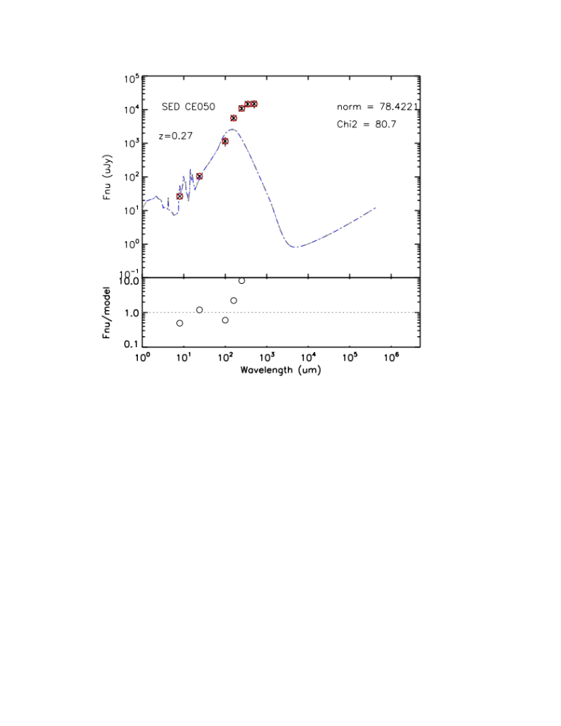
24um
500 um
z

Slide 10
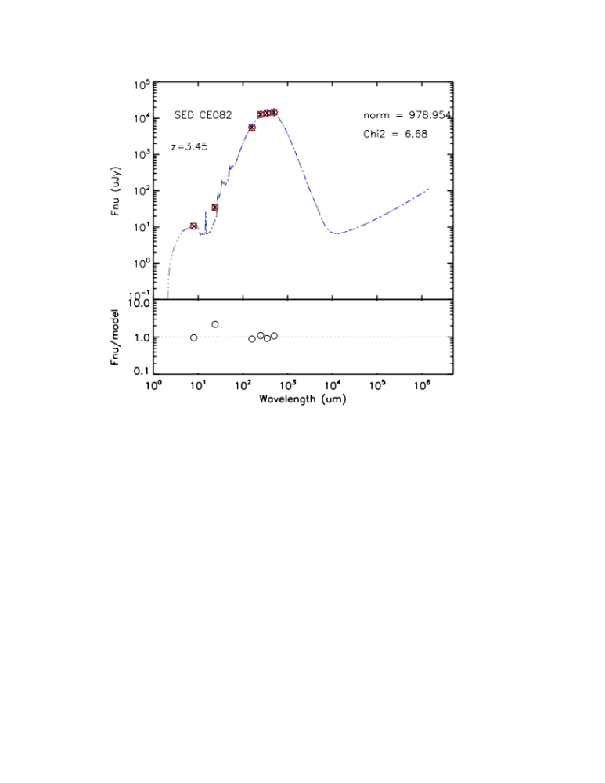
24um
500 um
z
1. By “Spectral” deconfusion:
(i.e., . Iteratively subtract the flux in SPIRE 350 and 500um of low-z sources based on redshift and best-fit templates,
2. The SED is in agreement with the high-z source’s
3. The SPIRE flux is not correctly measured in the catalog
4. Missed a population of candidates of high-z SPIRE sources?
>250um

Slide 11
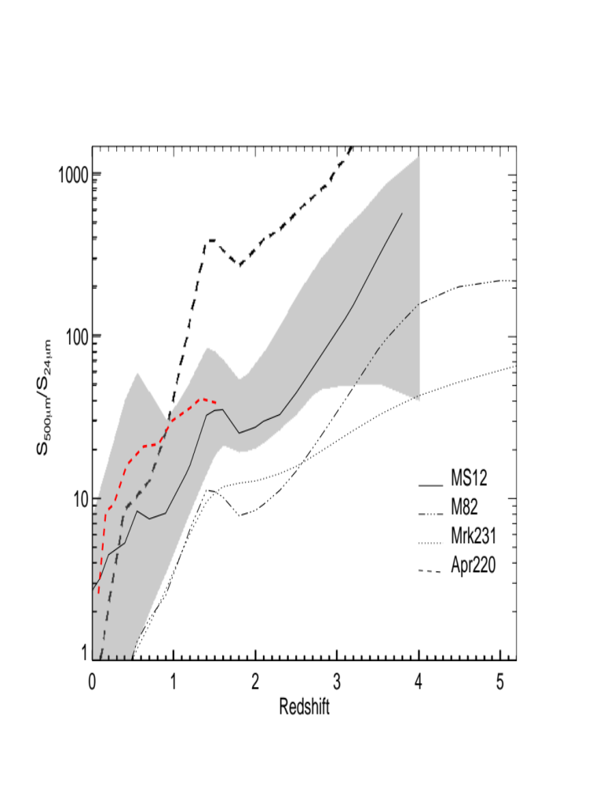
A new, but efficient method to systematically identify high-z Herschel 500um sources using color-deconfusion
Z>2

Slide 12
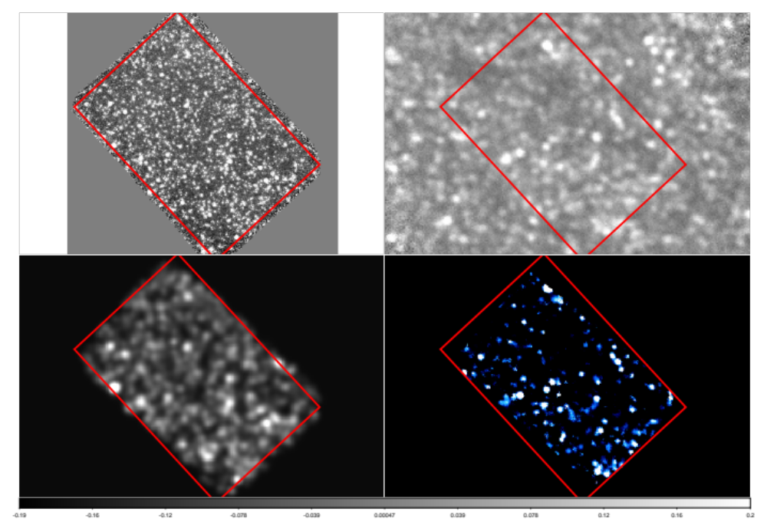
24 um original
Convolve with
SPIRE PSF
Convolved image
÷
Real 500 um map
Ratio of S_{500um}/S_{24um}*
GOODS-North Field

Slide 13
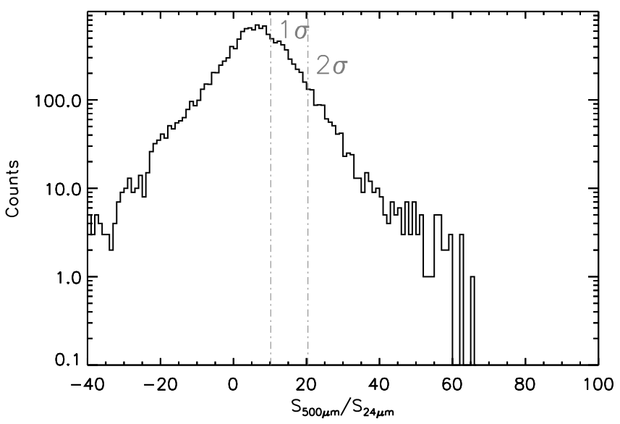
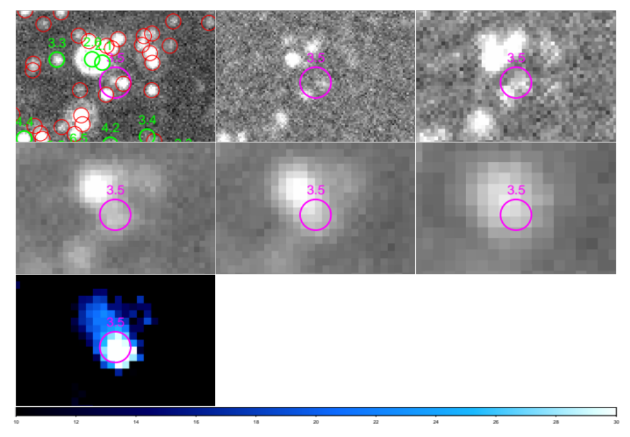
24um
100um
160um
250um
350um
500um
Ratio map
GN10, z=4.05, CO Daddi et al. 2009

Slide 14
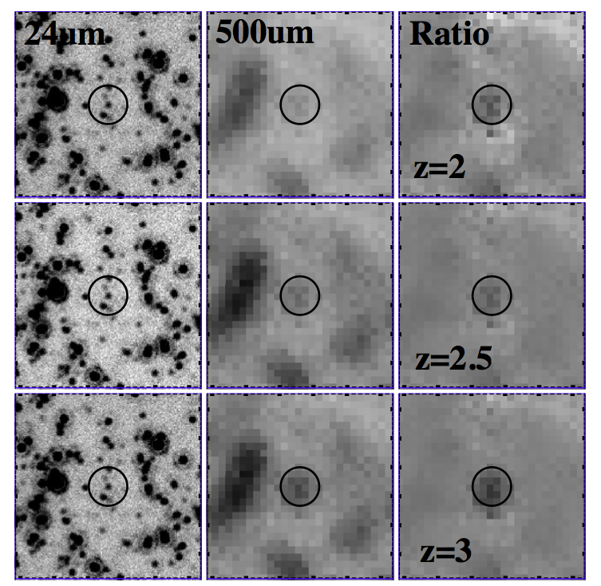
2.8 sigma
3.1 sigma
5.1 sigma

Slide 15
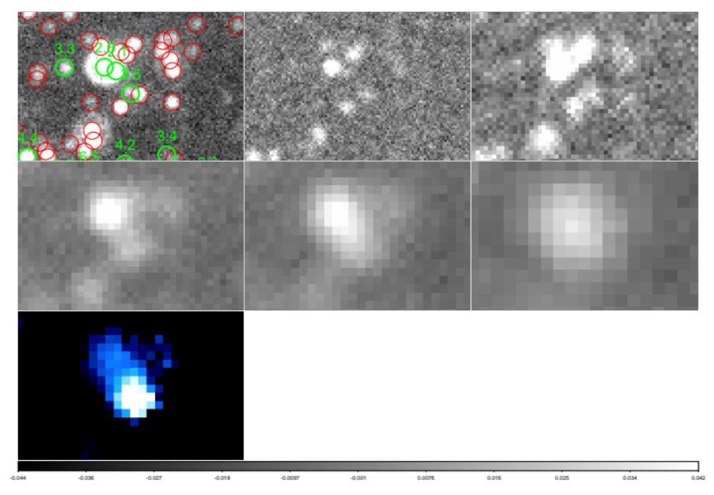
24um
100um
160um
250um
350um
500um
Ratio map

Slide 16
24um
100um
160um
250um
350um
500um
Ratio map
GN10, z=4.05, CO Daddi et al. 2009

Slide 17
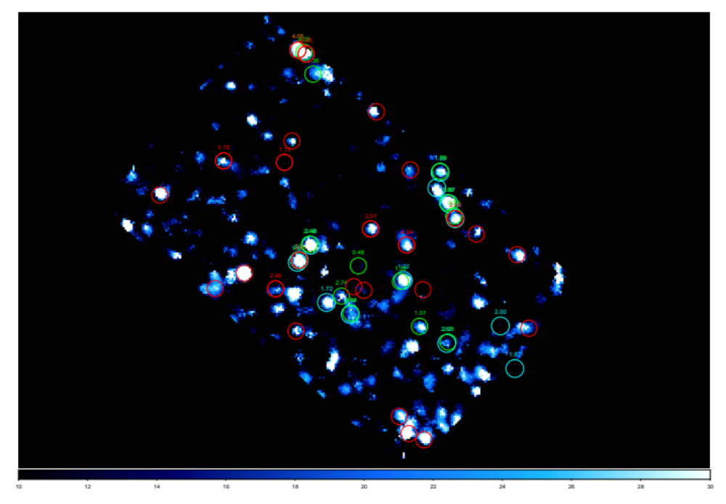
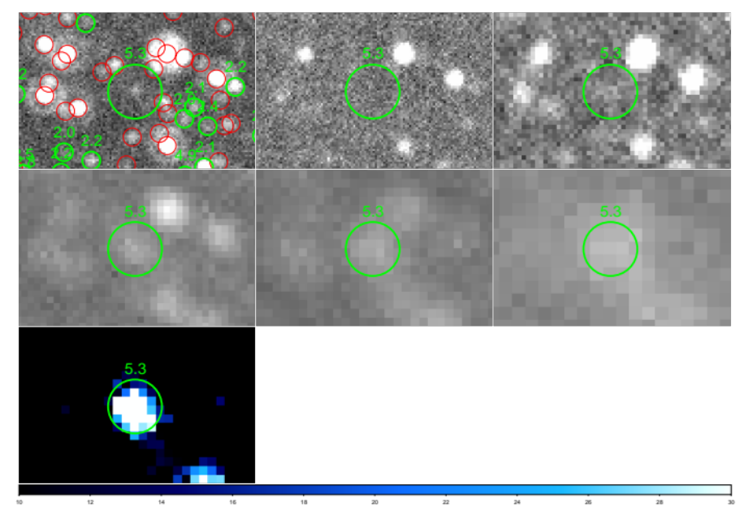
S_{500um}/S_{24um}
Ratio map
24um
100um
160um
250um
350um
500um
Test on the selection
efficiency:
Comparison with
(sub-)mm sources
(34 detected
at >2sigma)

Slide 18
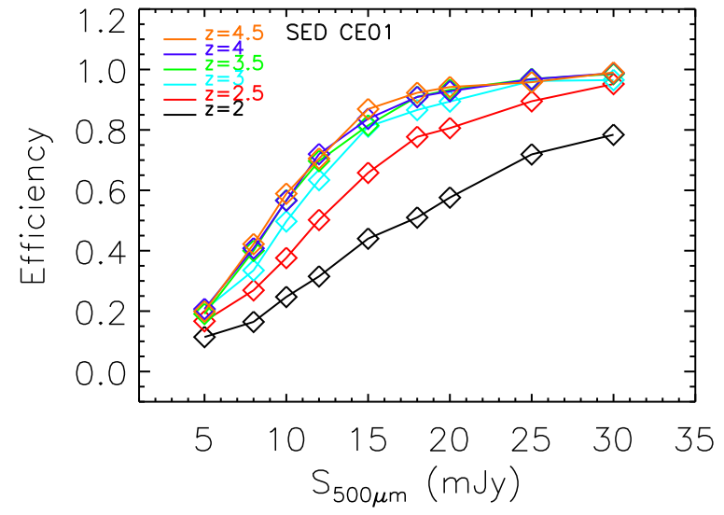
Test on the selection efficiency:
(2) M-C Simulations
Confusion limit

Slide 19
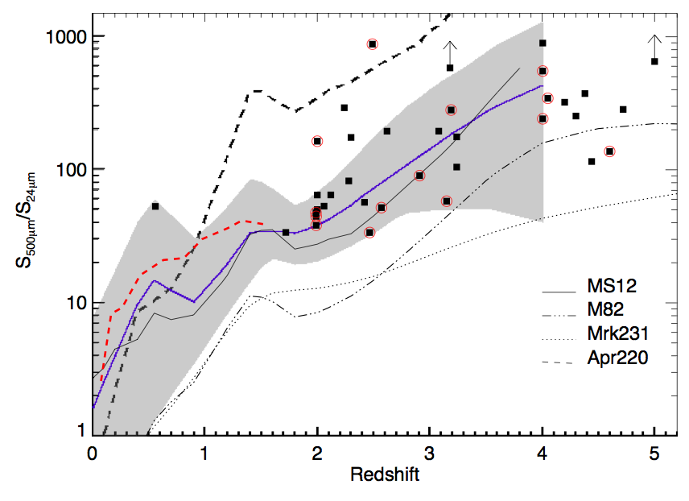
Shu et al. 2014, to be submitted

Slide 20
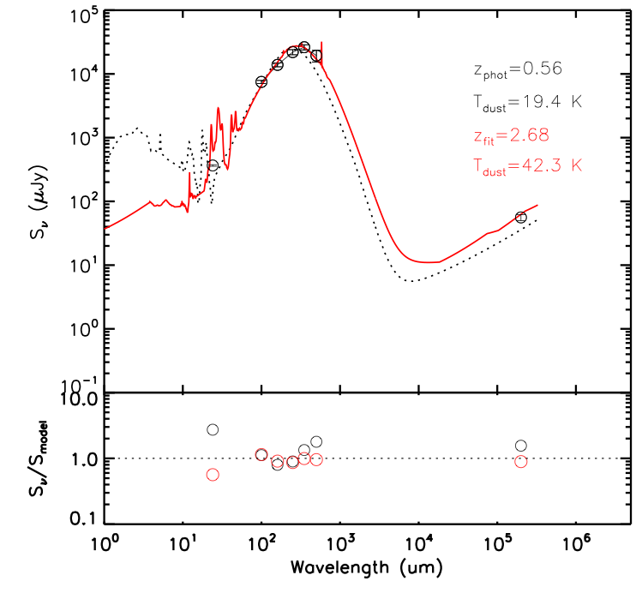

Slide 21
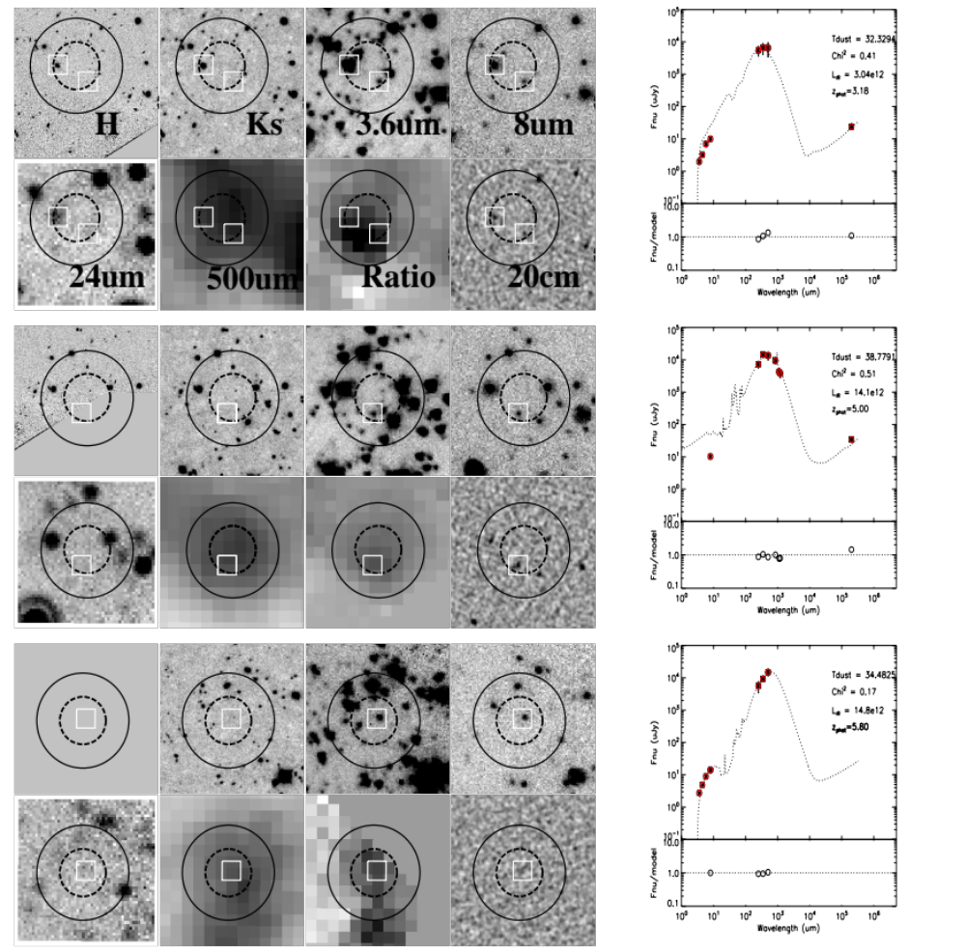
24um dropouts
H
Ks
3.6um
8um
24um
500um
ratio
Radio

Slide 22
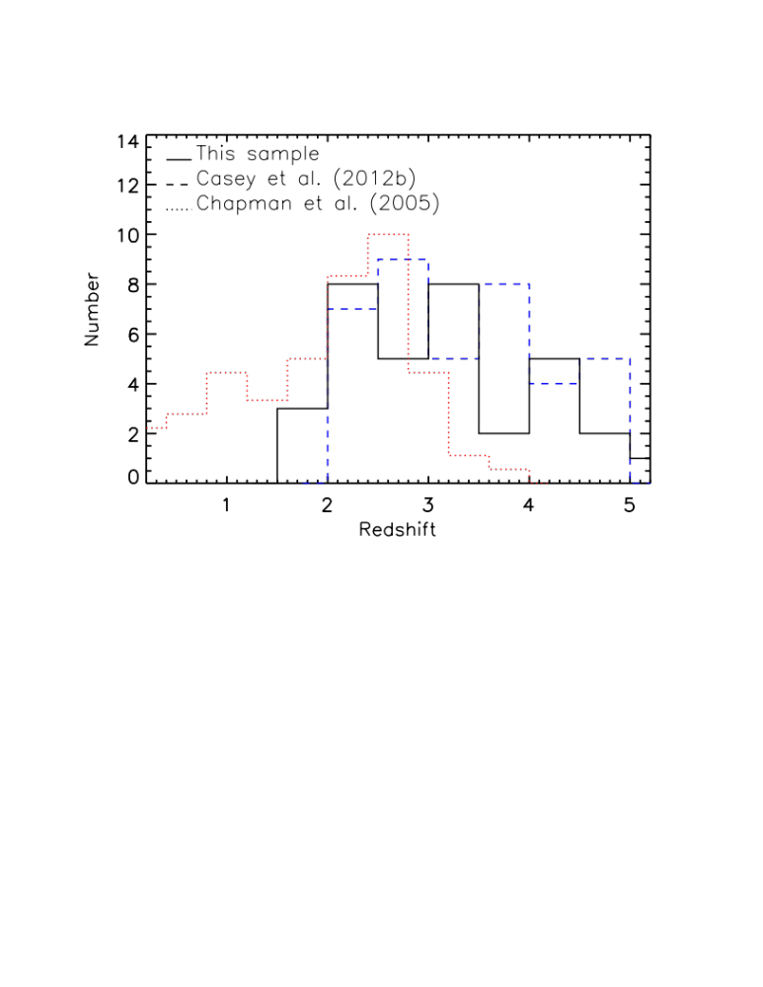
Redshift distribution of z>2 galaxies selected using color-deconfusion
Excess of z>3 sources

Slide 23
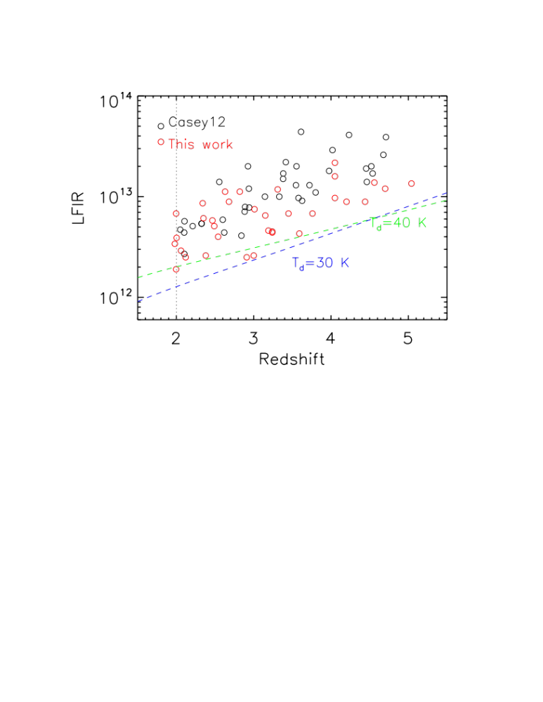
Lower FIR luminosity compared to the brighter SPIRE sources in HerMes fields

Slide 24
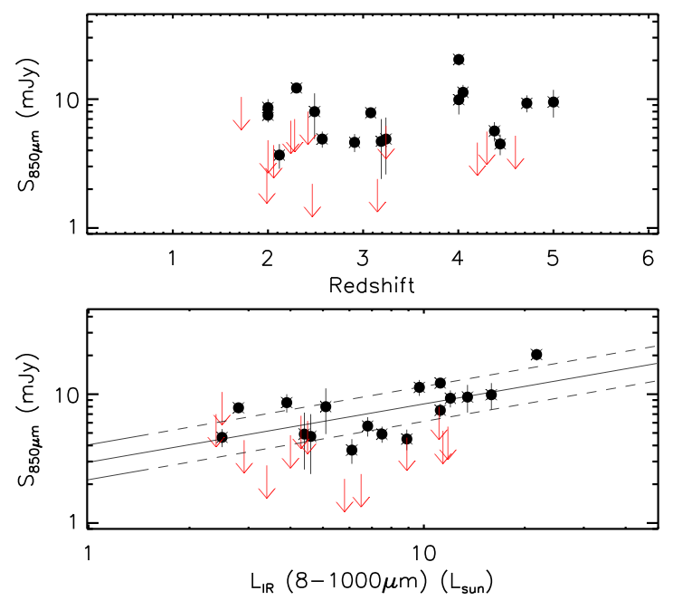
On the sub-mm non-detections

Slide 25
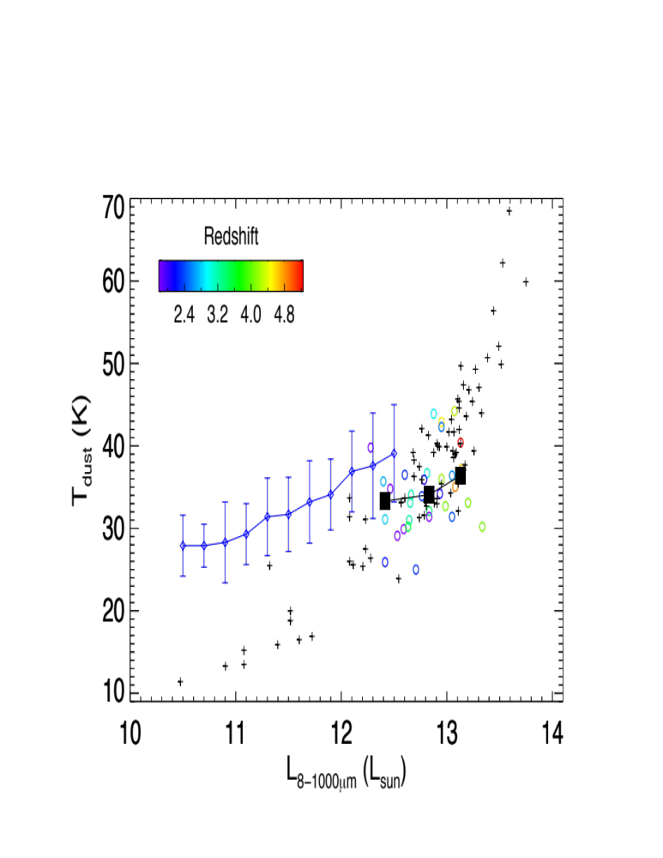
LIR vs Tdust relation: large scatter and Tdust is lower
than the low-z extrapolation
Plus: SMGs
Diamond: z<1 ULIRGs

Slide 26
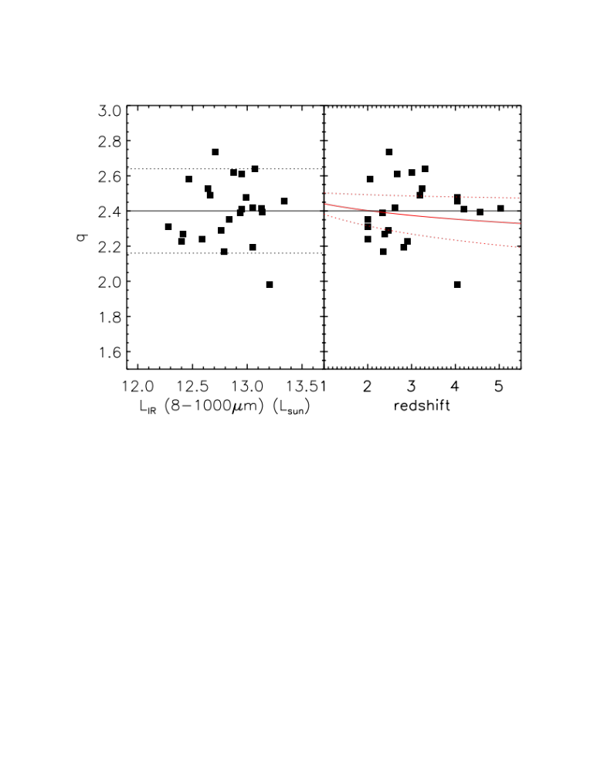

High redshift Radio/FIR relation

Slide 27
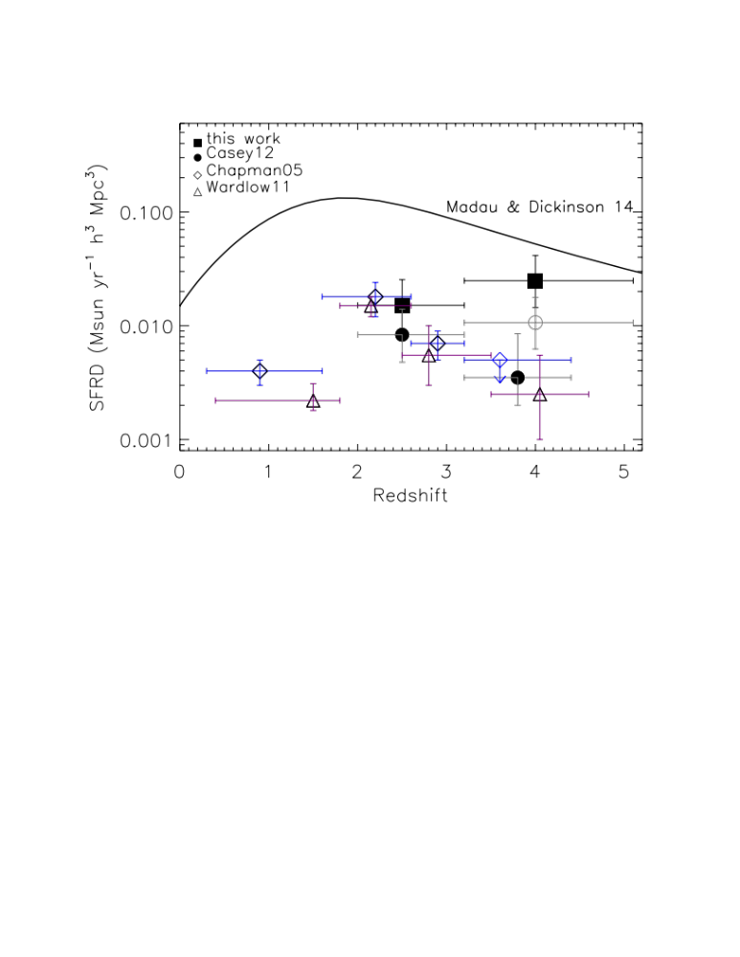
SFRD contribution: increase from z~2 to z~4？

Slide 28
Summary
The S_{500um}/S_{24um} ratio map is efficient in selecting high-z dusty star-forming galaxies (~60% for a “clean” 10mJy source at z>3)
More complete than other (confusion-limited) Herschel-selected sample which requires the detections in the 24um or radio
Discovery of 24um-undetected high-z sources
Refinement of the counterpart identifications of Herschel sources
We are applying for follow-up mm interferometric observations (IRAM)

Slide 29
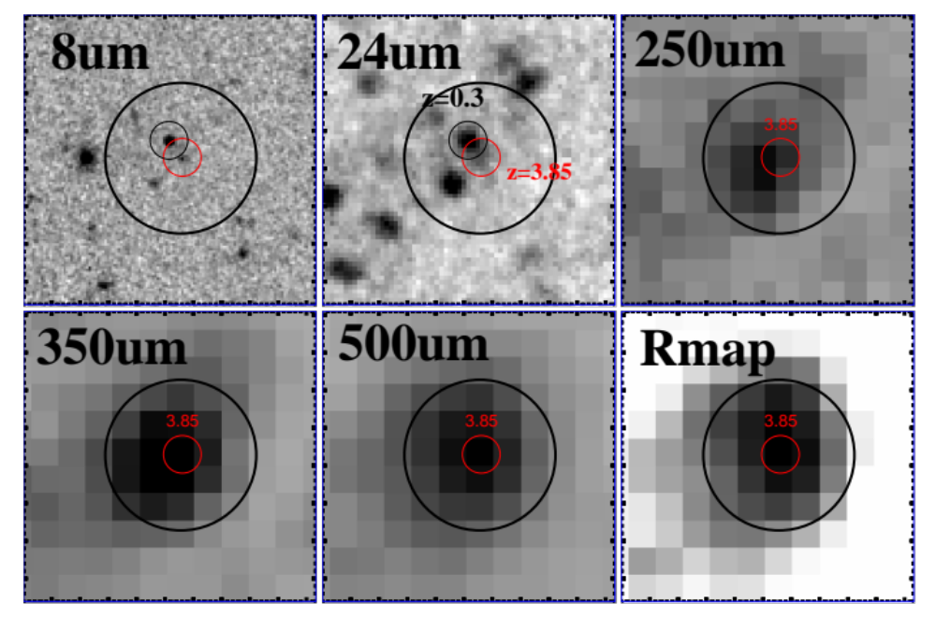
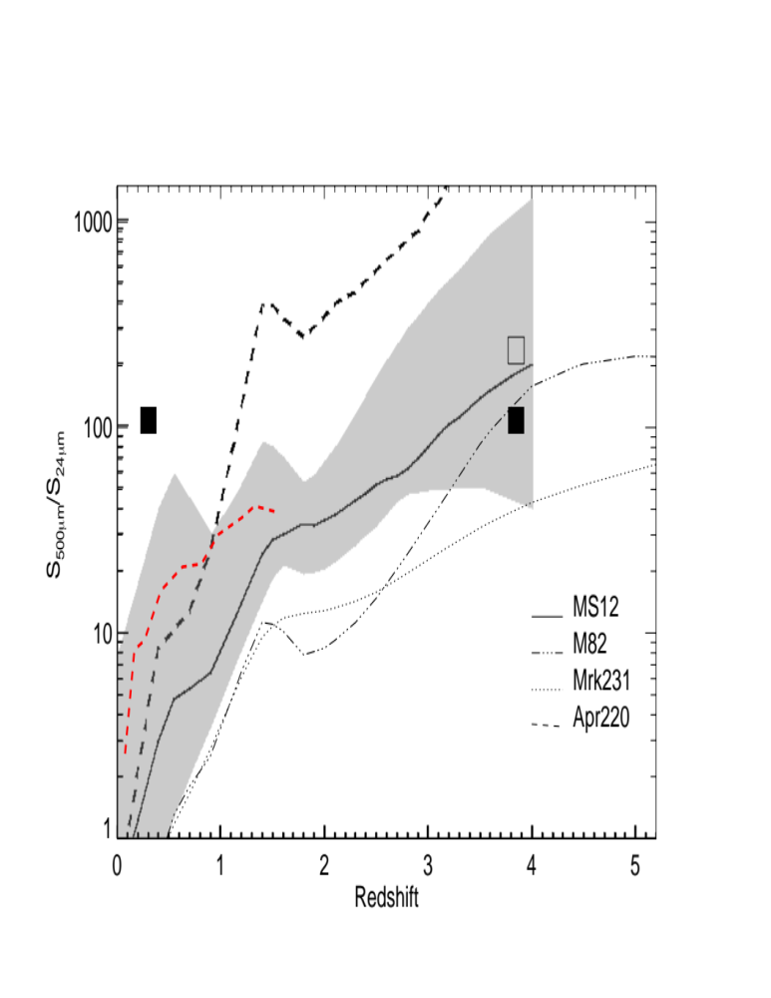
2 square degree
COSMOS field
Out of the CANDELS
and SCUBAII field

Slide 30
Thanks！

