Slide 1
Results of TPHOT tests on Herschel photometry and comparison with FASTPHOT
Xinwen Shu
CEA/Saclay
September 8, Rome

Slide 2
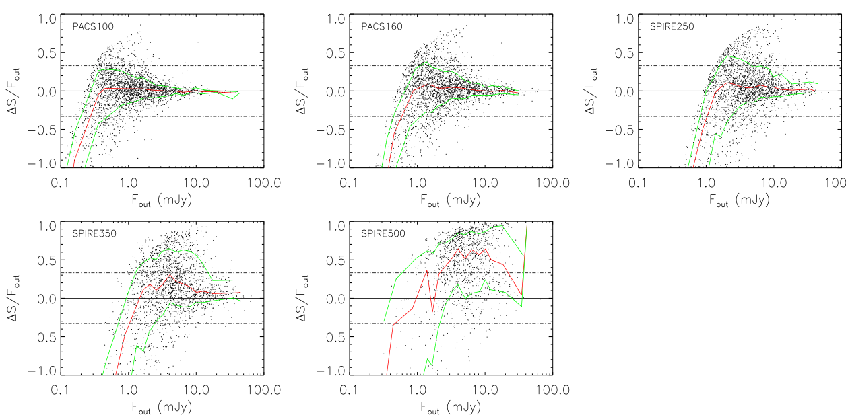
Comparison between input flux and output flux from TPHOT
Dashed lines: ΔS/S<0.33
VERSION1.4

Slide 3
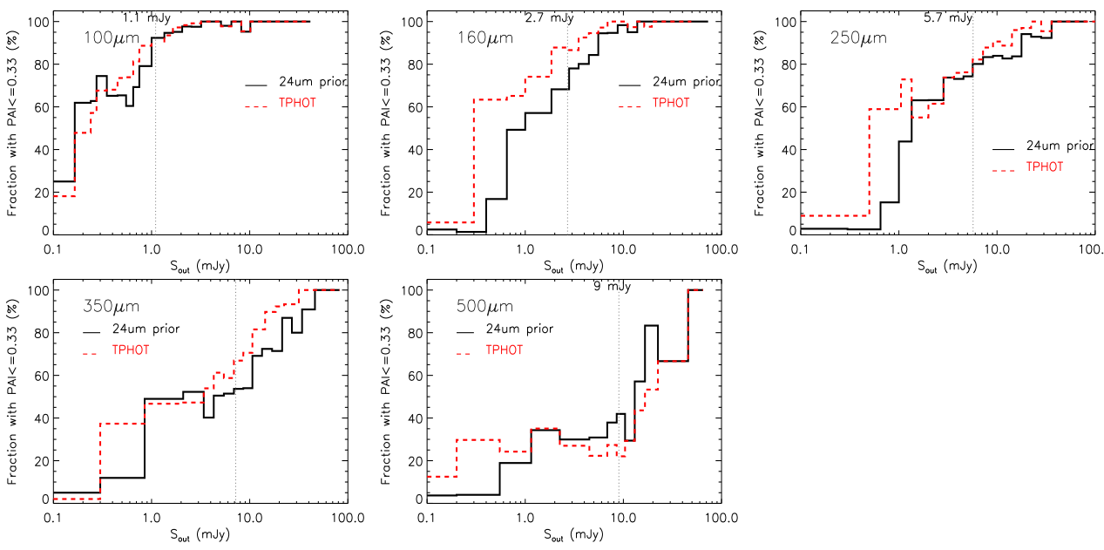
Comparison between TPHOT and standard 24um prior technique (Daophot-like)
Ex: >70% of the sources are detected with a photometric accuracy better than 33% above standard flux limits

Slide 4
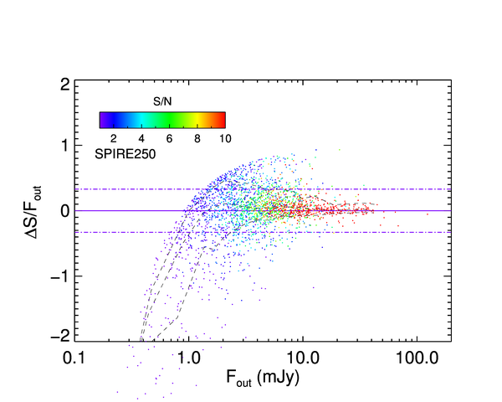
The S/N of output flux can be used to select “clean” sources

Slide 5
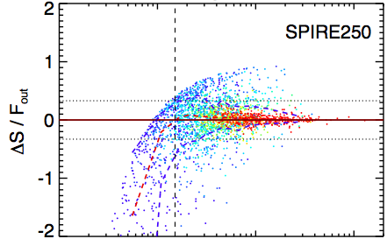
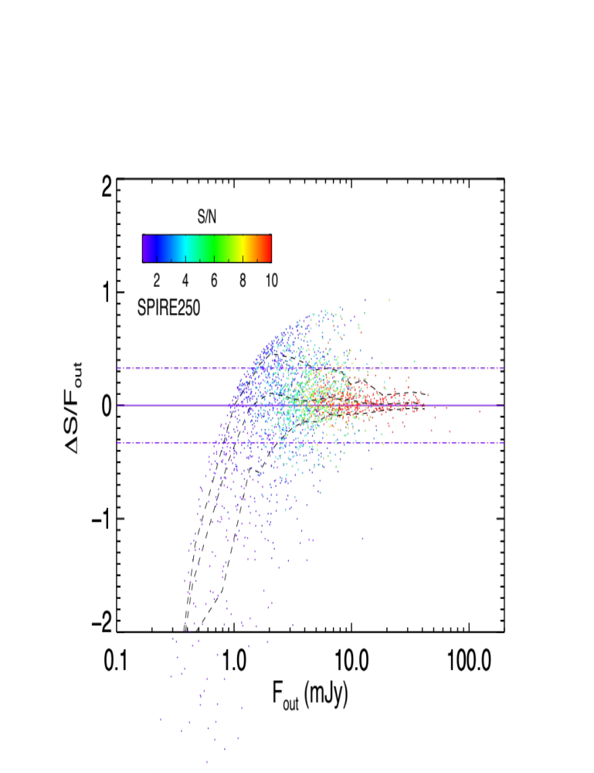
FASTPHOT
(From Tao)
TPHOT

Slide 6
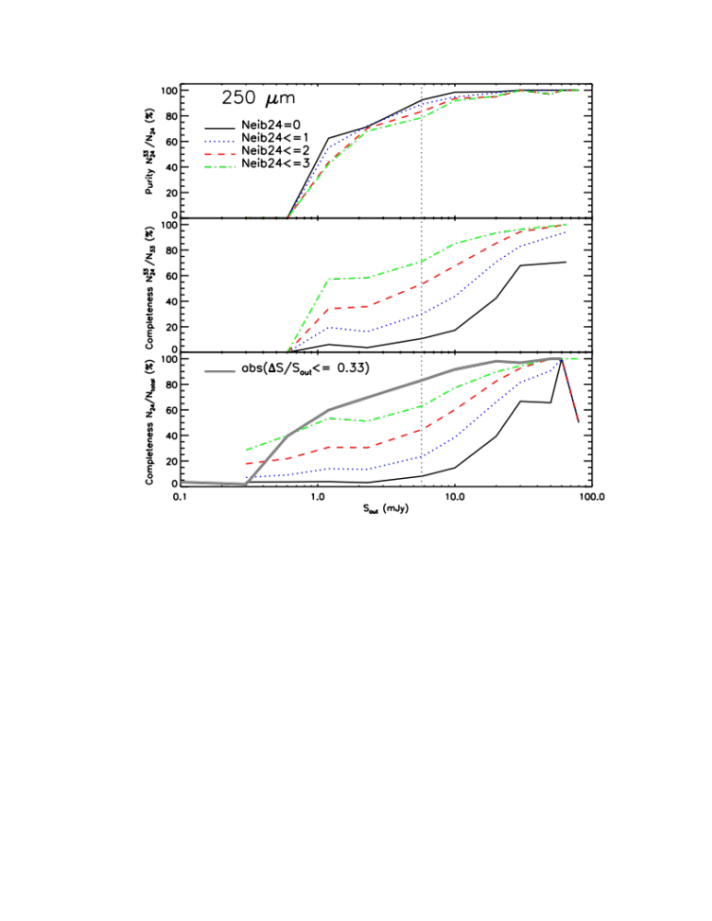
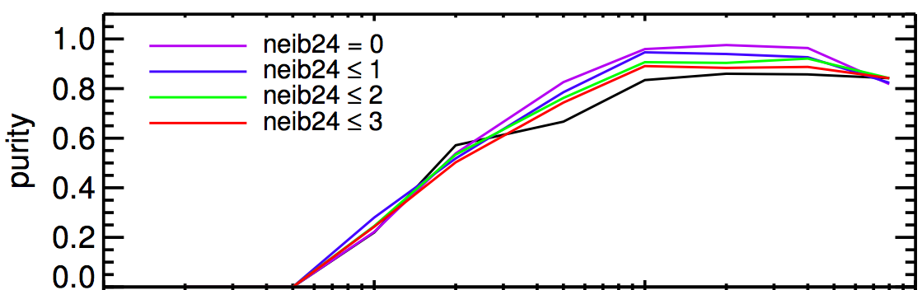
Purity: sources
with ni bright neighbors
have ΔS/S<0.33
TPHOT
FASTPHOT
From Tao

Slide 7
FASTPHOT
(From Tao)
TPHOT

Slide 8
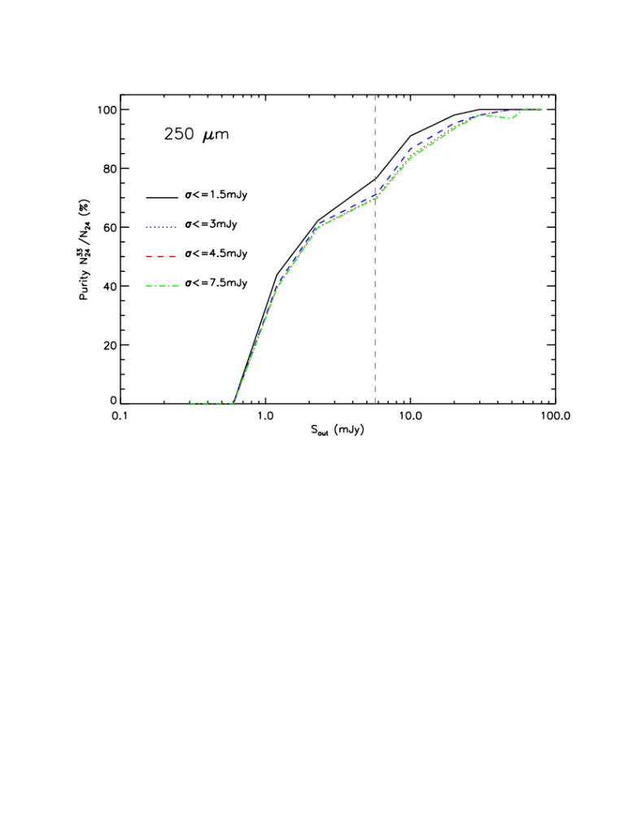
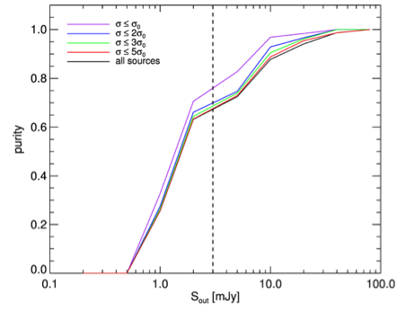
The errors from covariance matrix can be used instead of clean index to select clean srcs
TPHOT
FASTPHOT
(From Tao)

Slide 9
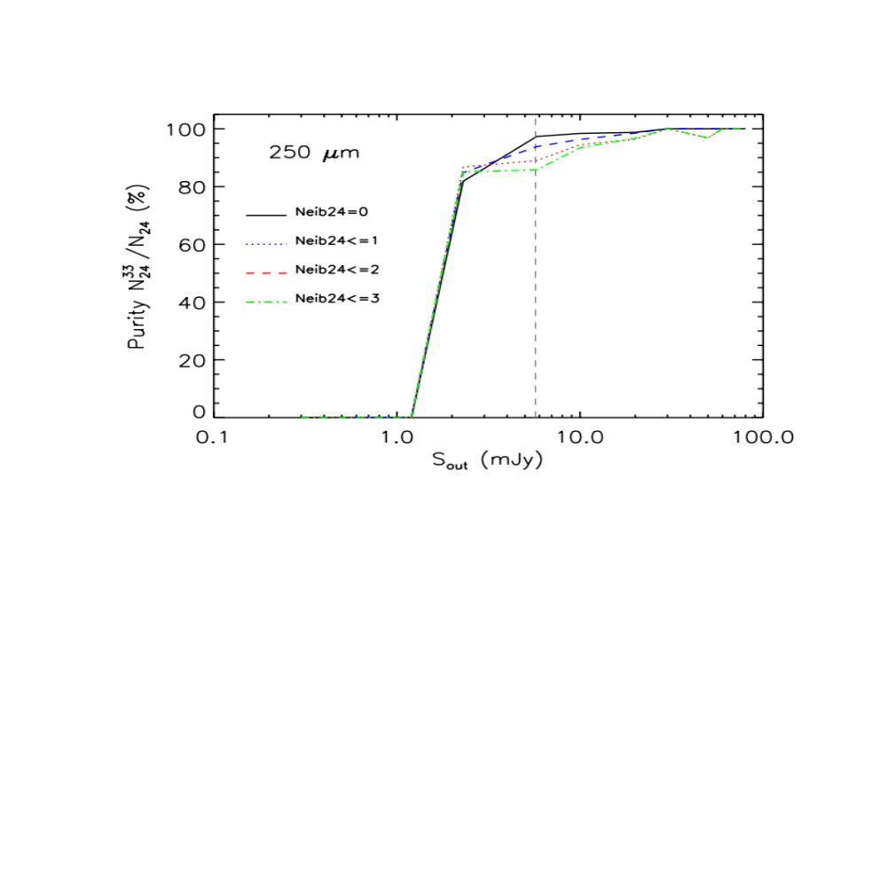
Sources with
S/N>3sigma (output)

Slide 10
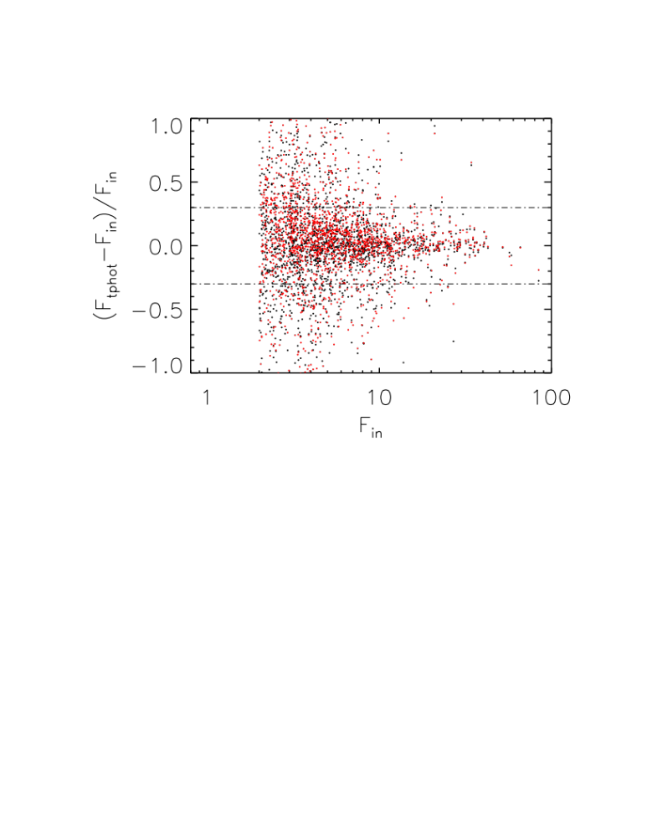
Comparison between output flux from TPHOT (red) and FASTPHOT (black)

Slide 11
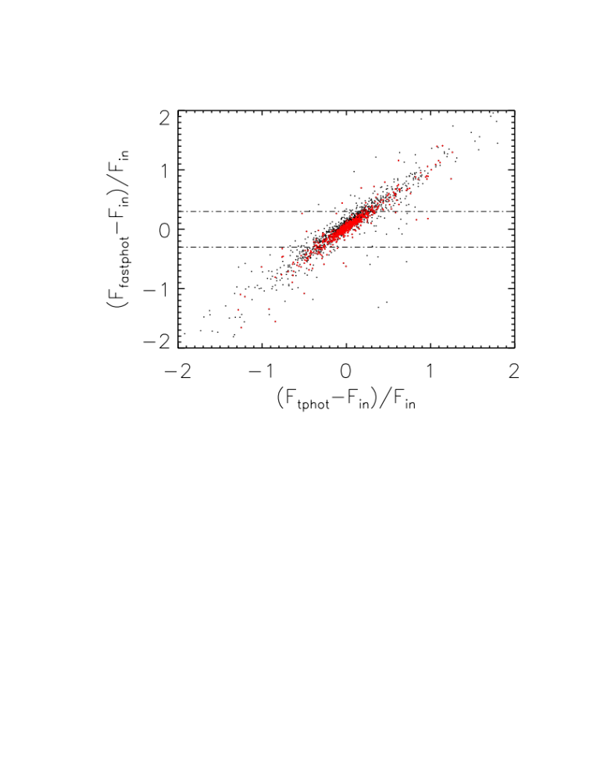
Black: Sin>2mJy
Red:
Sin>5mJy

Slide 12
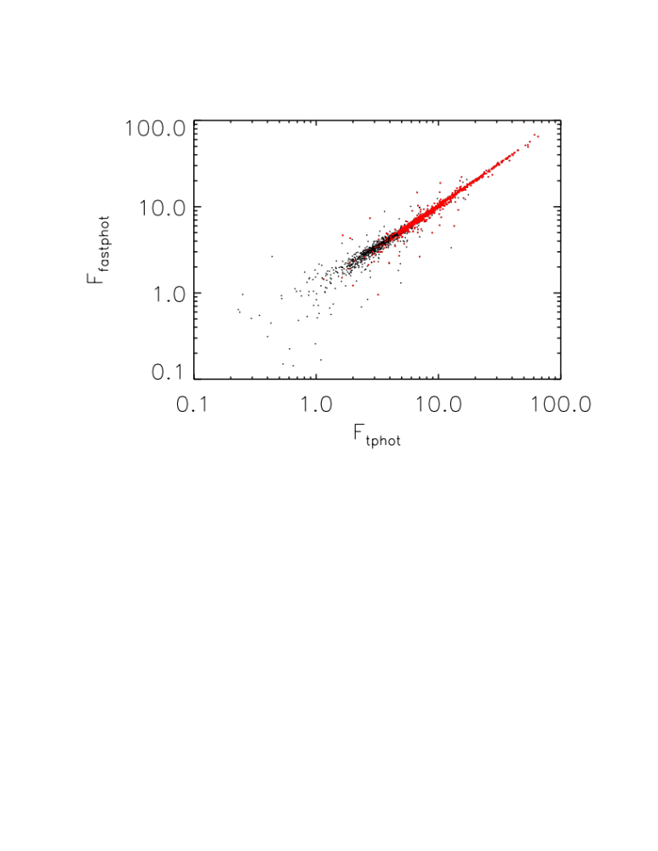
Black: Sin>2mJy
Red:
Sin>5mJy

Slide 13
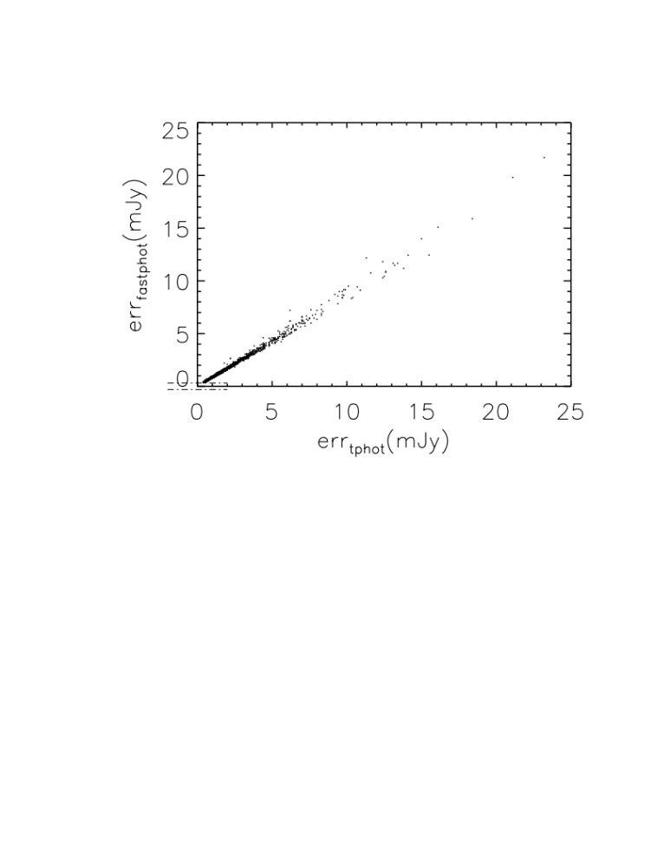

Slide 14
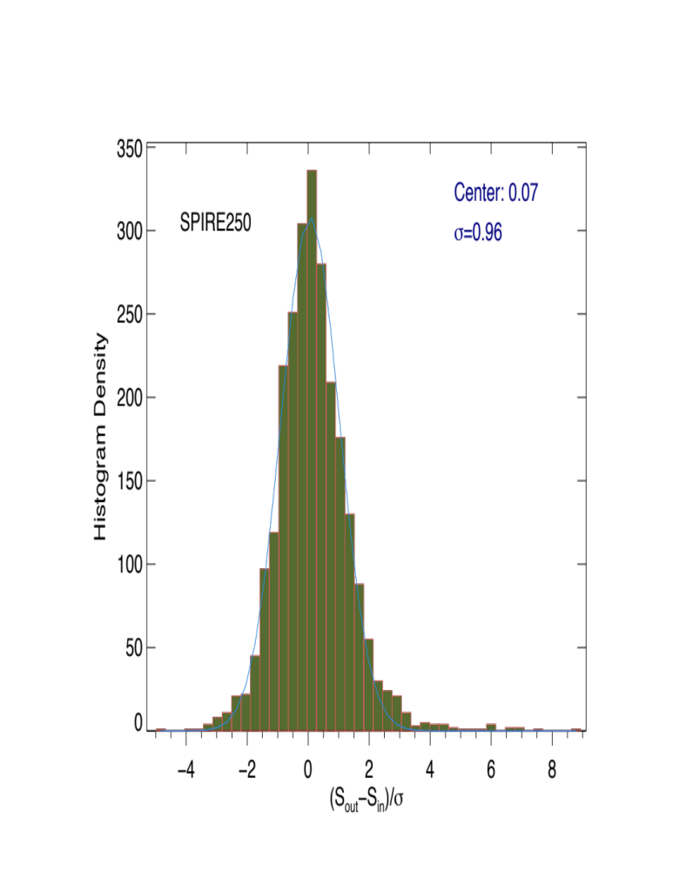

Slide 15
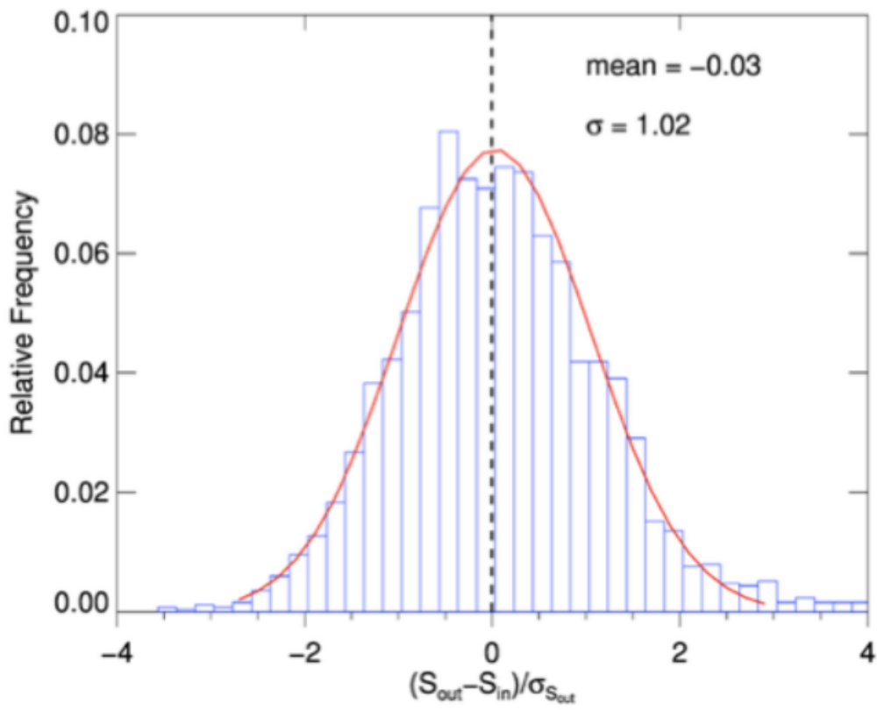
FASTPHOT

Slide 16
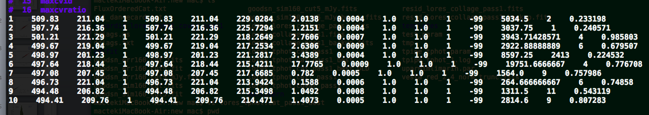
Suggestions
Hi, Emiliano,
Is it possible to provide the TPHOT output fluxes with higher numerical precision?
PACS160um, image unit mJy/pixel

Slide 18
Purity: fraction
Of srcs with ΔS/S<0.33
among 24um sources
with neib24<I

