Slide 1


K-selected sources
Dataset:
We used the HAWK-I K band for the GOODS-S and the HST H band.
The K band was resampled to the the H band pixel scale.
We computed the PSF of the resampled K and of the H band
Created Kernel and we smoothed the H band to the K band seeing (0.43”).
Create mask to only take into consideration the areas in common.

Slide 2
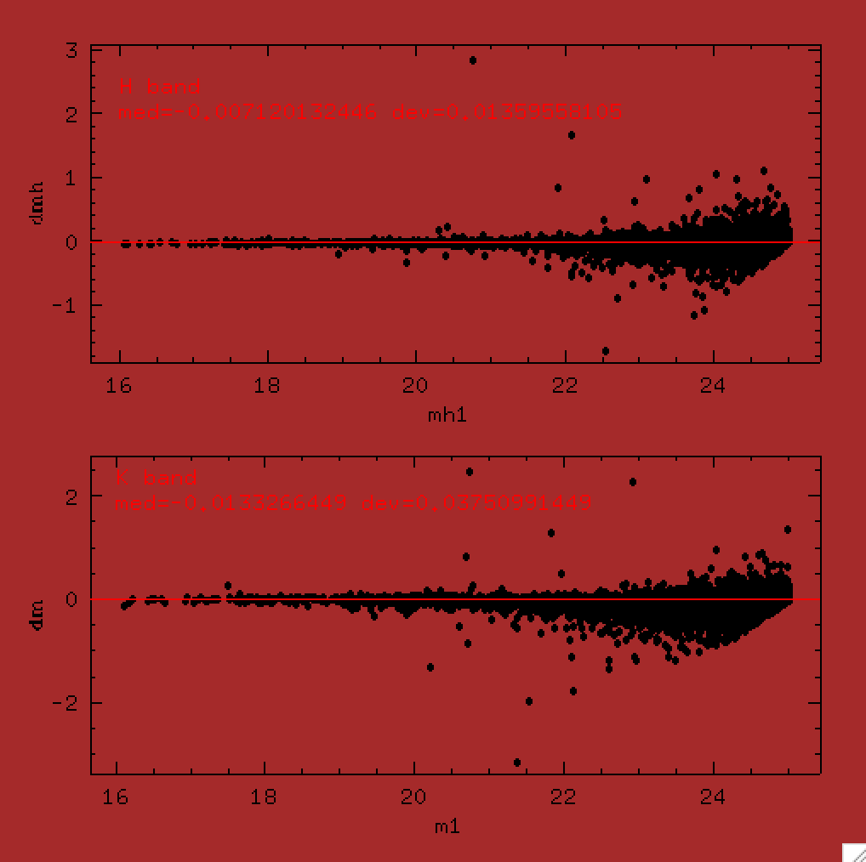
K-selected sources
Sextractor in dual mode (mag_best):
1σ limit in K: 27.44
After crosscorrelating with the Guo catalog (0.5” radius) we find:
192 sources not in Guo
138 if we consider sources with SN_K>5

Slide 3
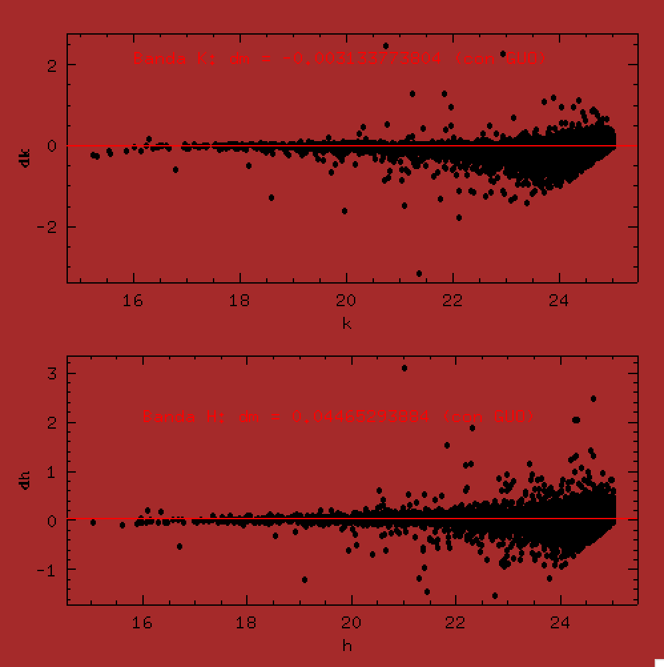

K-selected sources
Sextractor in dual mode (method 2):
The mag in the H band is measured by scaling the flux in the K band with the color term between the two PSF-matched bands.
An additional term is applied when isoarea<100pix to compensate for flux losses in the faint sources.

Slide 4
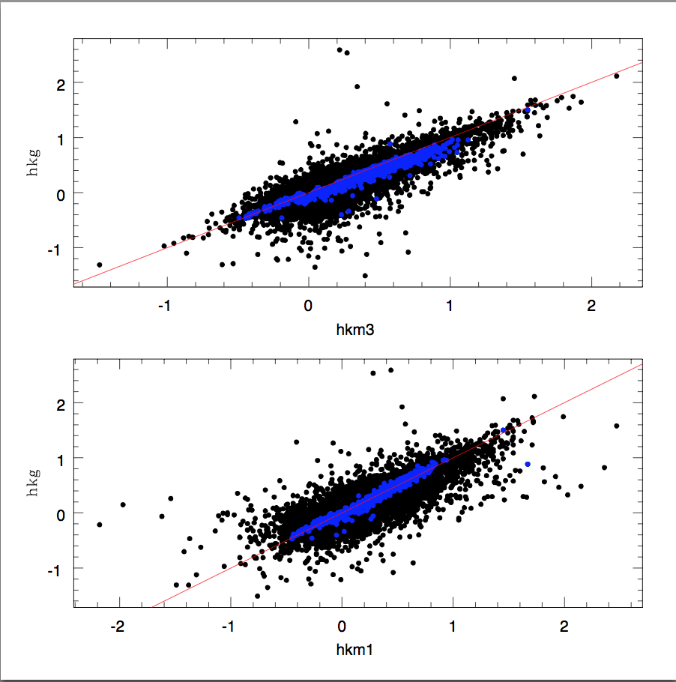
K-selected sources
Sextractor in dual mode (method 2):
Comparison of (H-K) calculated with the two methods.
To select “H-dropout” we take sources with SN_K>5 and SN_H<=2.5
67 sources of which 45 (~67%) in common with method 1.

Slide 5
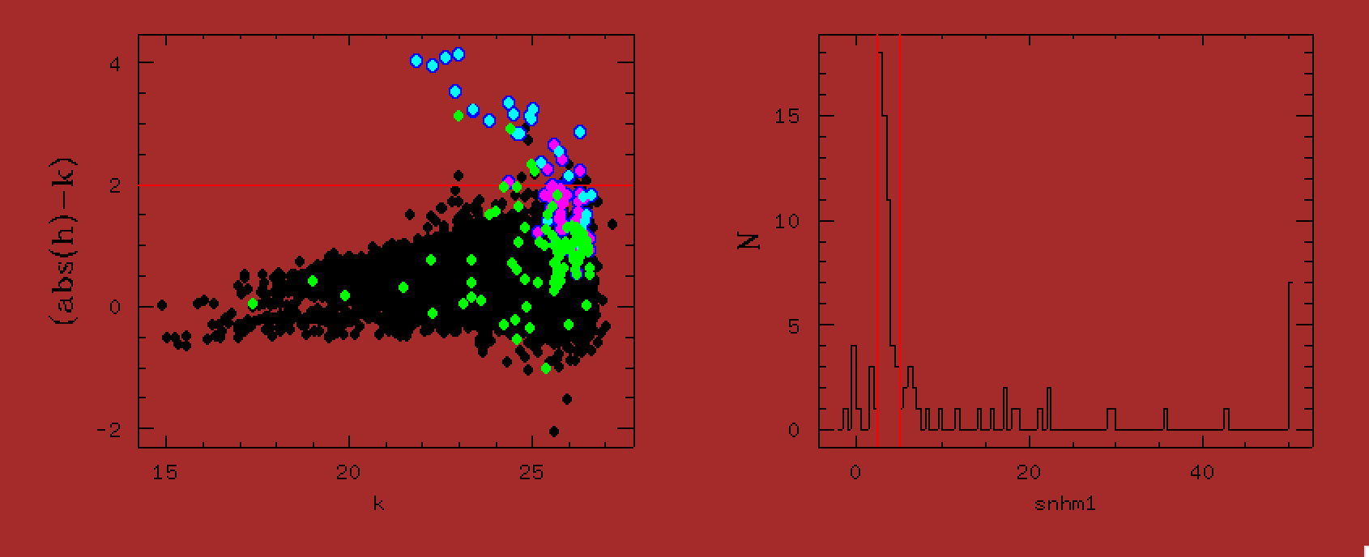
K-selected sources
Comparison of selected sources:
After visual inspection of thos 67 sources we see that 44 can be seen also in other bands (magenta).
Green sources are found by method-1 but not method-2 – on the right the histogram of SN for these sources

Slide 6
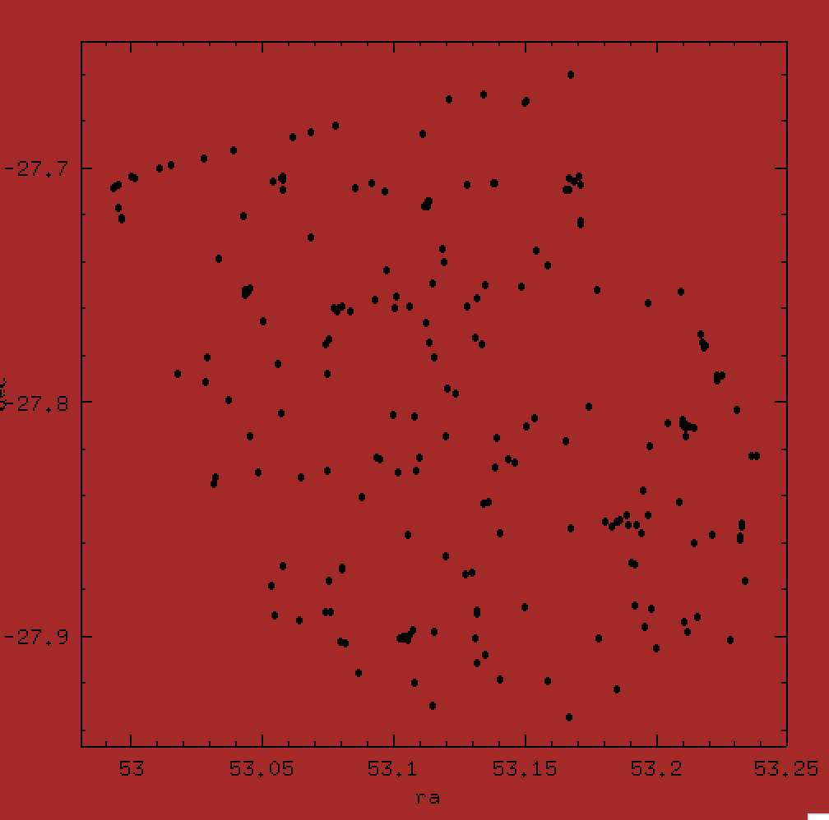
K-selected sources
Run TPHOT on Kband residual image:
Used HST H-band image, the Guo catalog and segmentation as input to subtract all sources from the K-band image with TPHOT.
After SExtractor on the residuals image we find 206 sources with flag<3.
Comparing with method1 there are 85 sources in common.
Work in progress – understand better the differences between sources selected with the two methods.

Slide 7
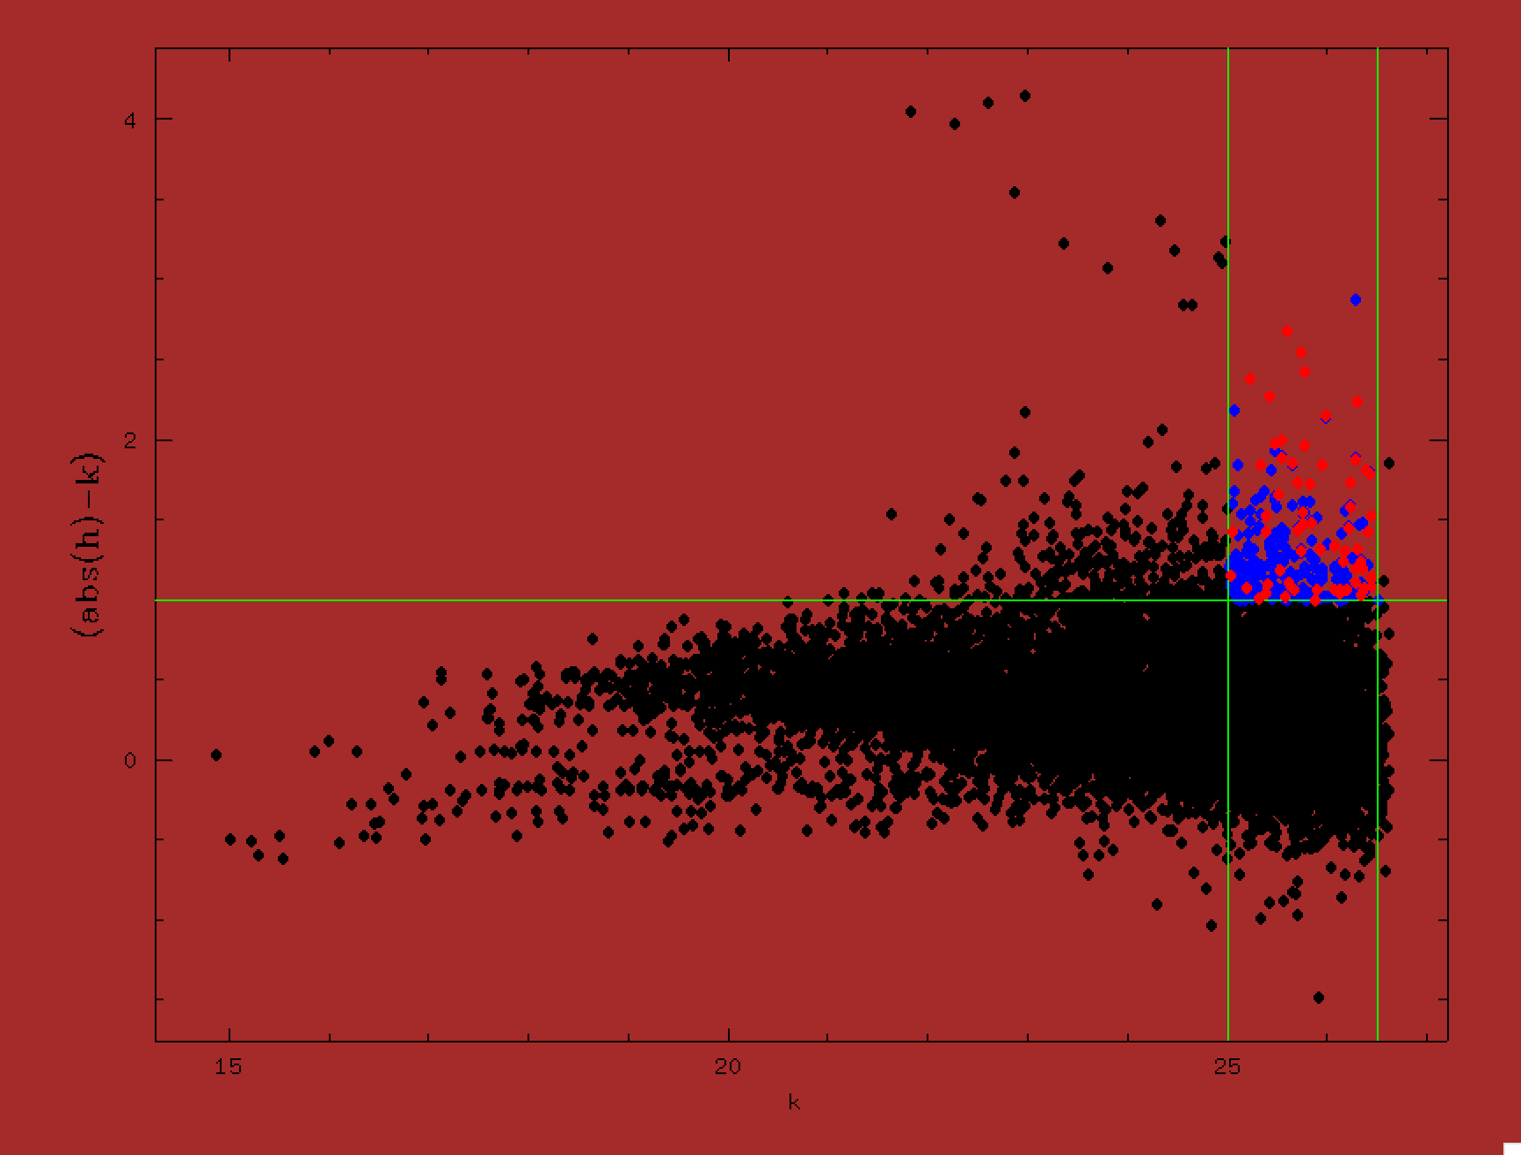
K-selected sources
Some examples:
There are 274 sources with SN_K>5 and
(H-K)>1.0 (blue).
64 (23%) are not in the Guo catalog (red).

Slide 8
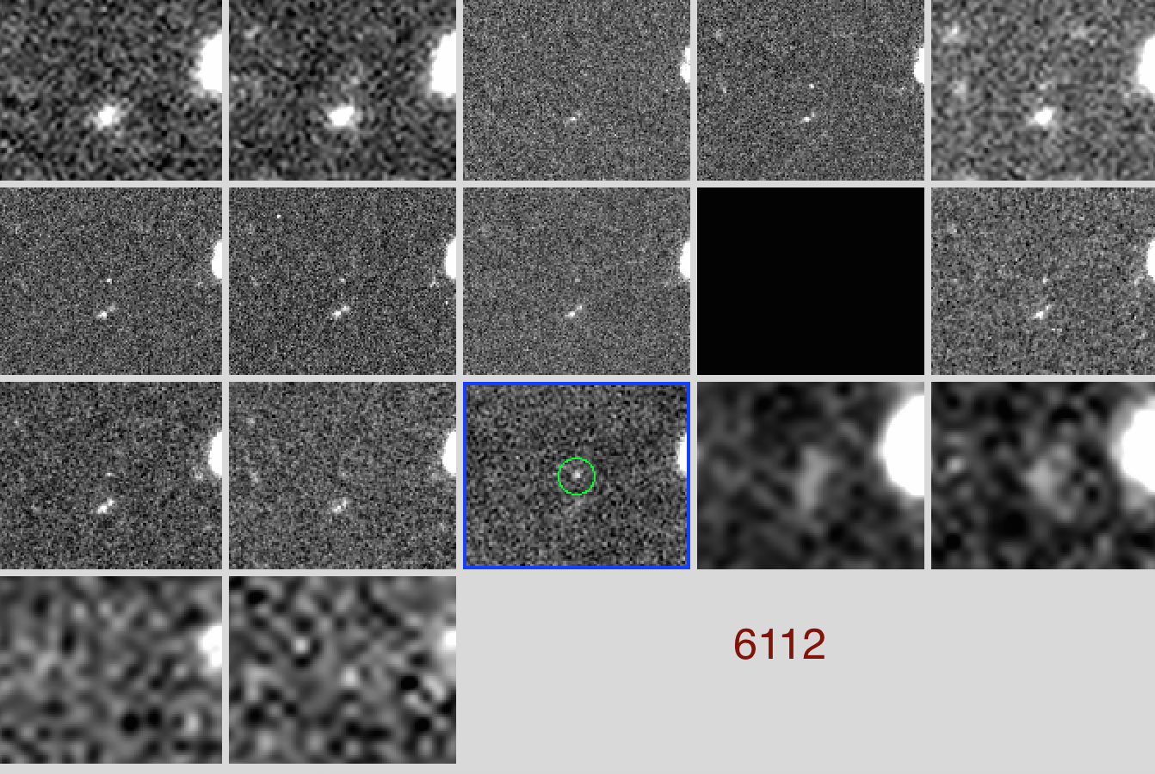
K-selected sources
U.fits, BV2.fits, B435_V3.fits, V606_V3.fits, R.fits,
I775_V3.fits, I814.fits, Z850_V3.fits,Y098.fits, Y105.fits,
J125.fits, H160.fits, KhawkI.fits, irac.36.fits, irac.45.fits,
irac.58.fits, irac.80.fits

Slide 9
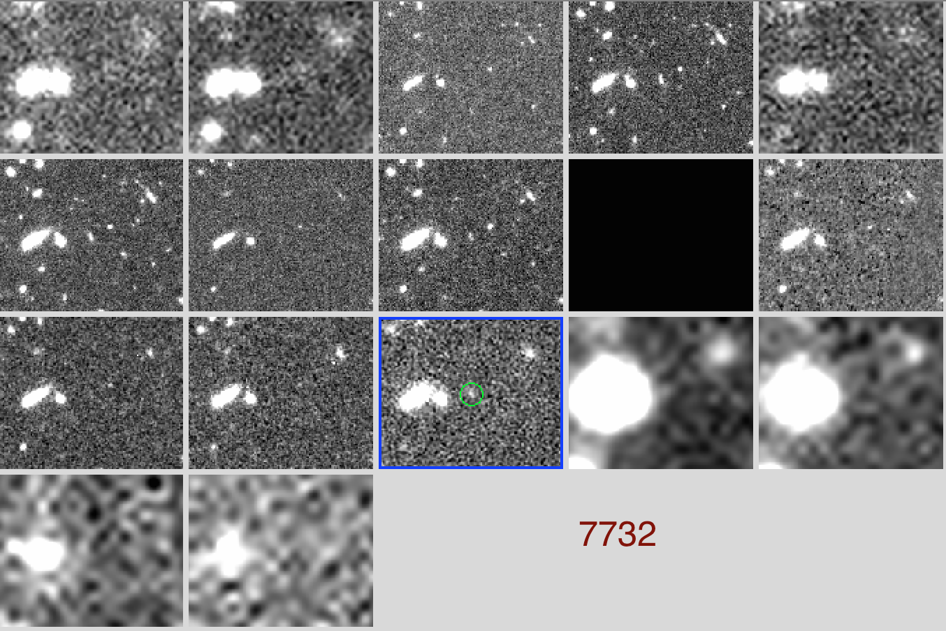
K-selected sources

Slide 10
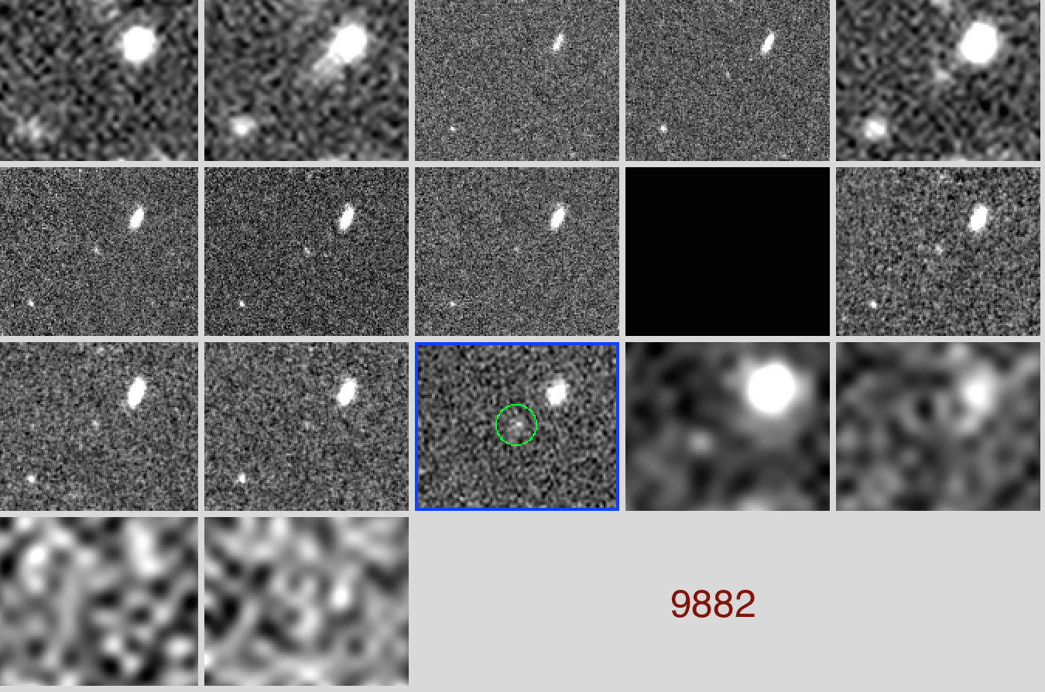
K-selected sources

Slide 11
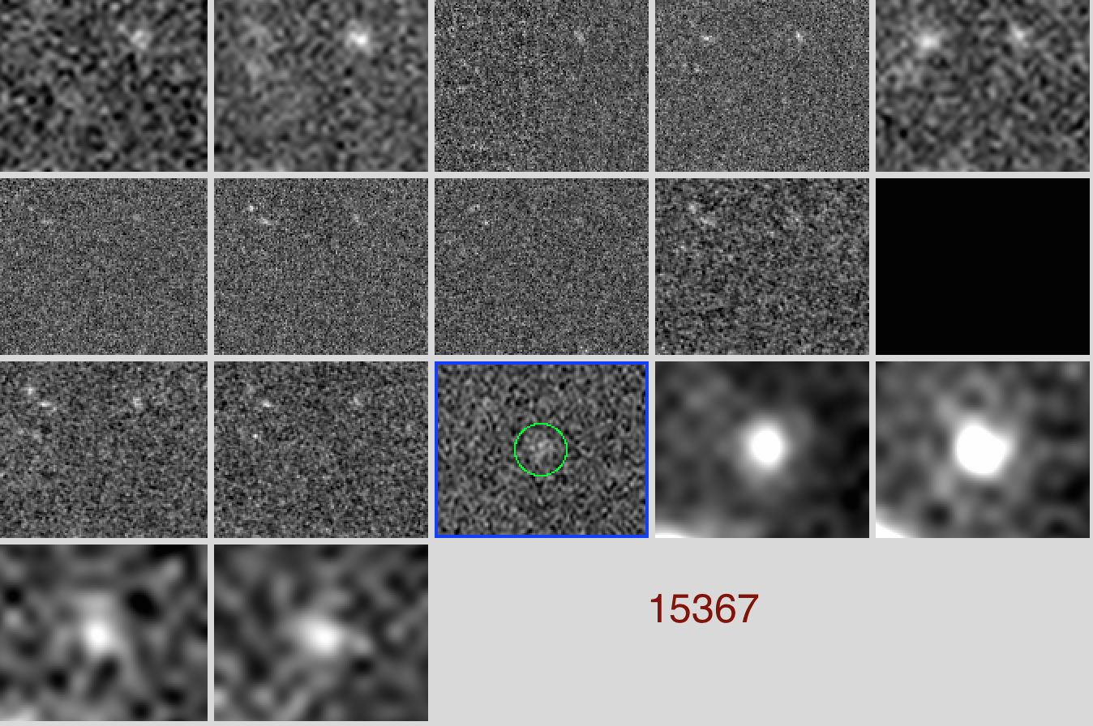
K-selected sources

Slide 12
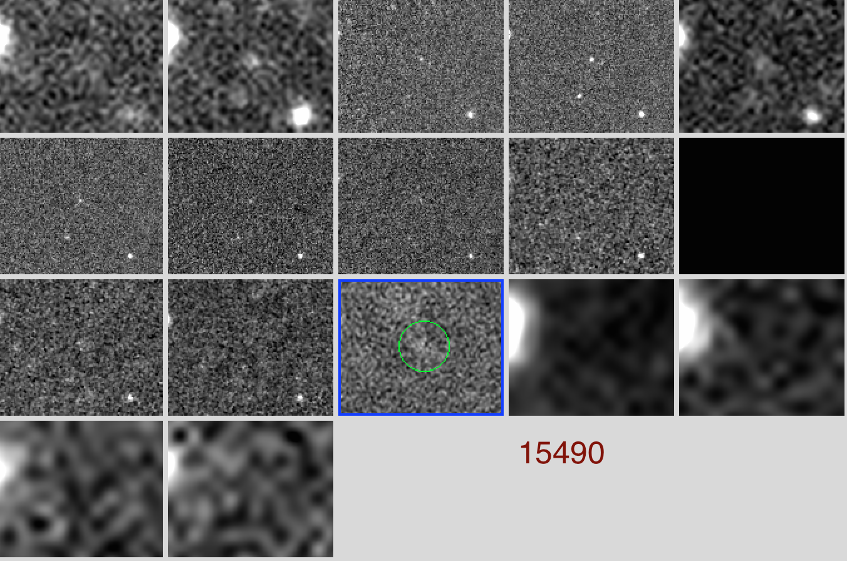
K-selected sources

