Slide 1


K-selected sources
Dataset:
We used the HAWK-I K band for the GOODS-S and the HST H band.
The K band was resampled to the the H band pixel scale.
We computed the PSF of the resampled K and of the H band
Created Kernel and we smoothed the H band to the K band seeing (0.43”).
Create mask to only take into consideration the areas in common.
Perform dual mode photometry in all HST bands available
Use TPHOT to calculate IRAC magnitudes

Slide 2
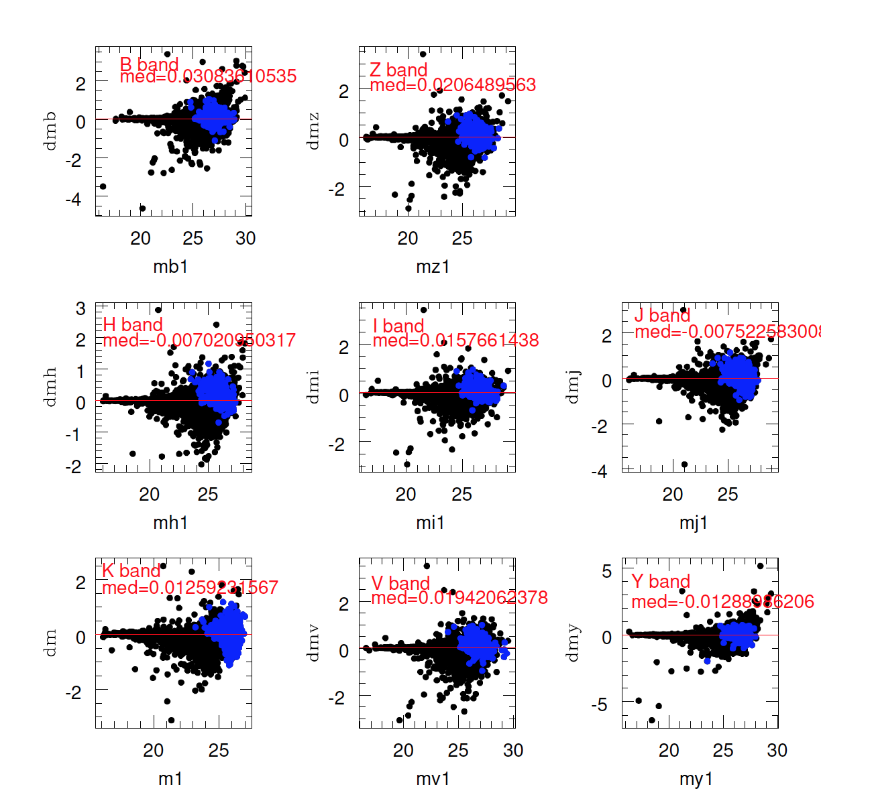
K-selected sources
Comparison of photometry in various bands.
We detect 184 sources with SN_K>5 and no Guo counterpart.
The mag in all other bands is the automag computed at the position of the K detection.
When the source has and isoarea <60pix an additional term is applied to compensate for flux losses in the faint sources.

Slide 3
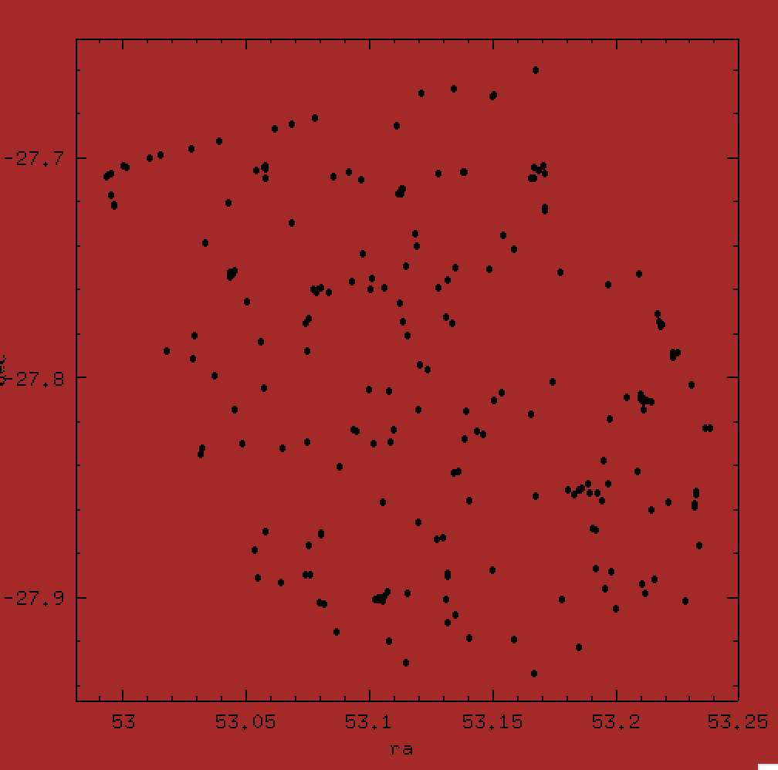
K-selected sources
Run TPHOT on Kband residual image:
Used HST H-band image, the Guo catalog and segmentation as input to subtract all sources from the K-band image with TPHOT.
After SExtractor on the residuals image we find 267 sources of which only 170 with SN_K>5.
80 of these sources are in common with the catalog of K-detected.

Slide 4
K-selected sources
Thus we have a total of 272 K-selected source that we visually inspect and flag in 4 categories:
C1: Detected in more bands
C2: Detected only in K
C3: Tentative detection in K (faint)
C4: Errors
We consider as valid candidates sources in C1/2/3 and have:
78 Kdet –ONLY valid candidates (C1:61/C2:6/C3:11)
80 Kdet+Kres valid candidates (C1:77/C2:3/C3:0)
38 Kres-ONLY candidates (C1:36/C2:2/C3:0)
Total: 196 K selected candidates (C1:174/C2:11/C3:11)
We also include the 5 Tao-candidates for a total of 201 H-dropouts

Slide 5
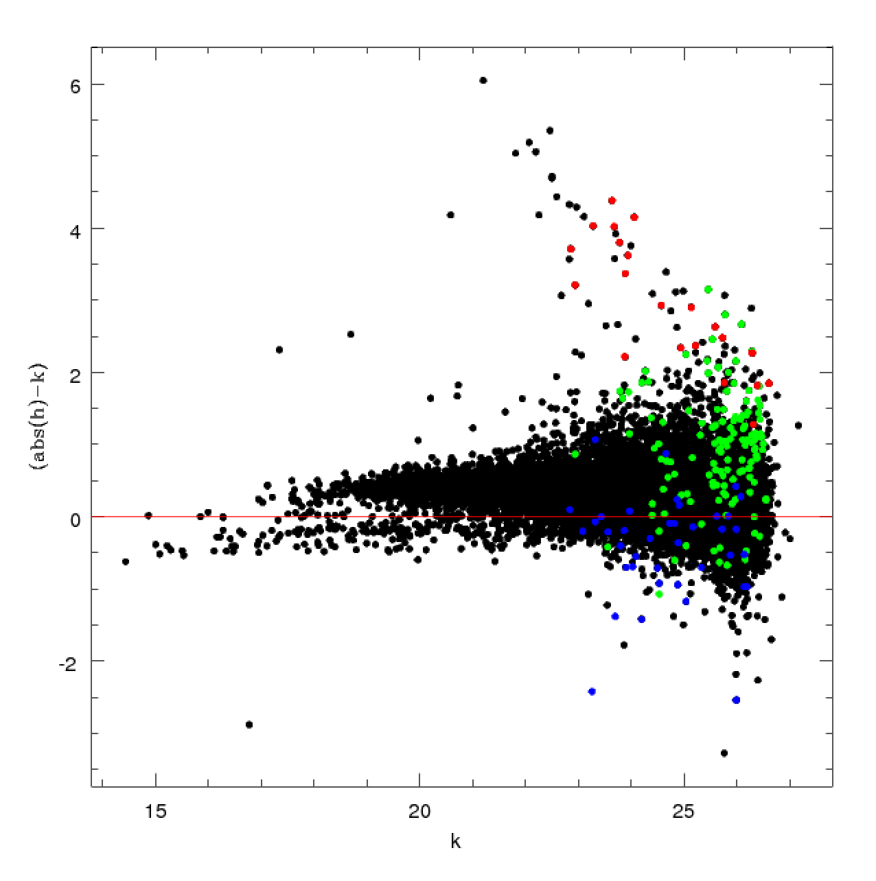
K-selected sources
Red: SN_H<1
Green: 1<SN_H<5
Blue: SN_H>5
Objects with SN_H>5 usually are close to bright star haloes.

Slide 6
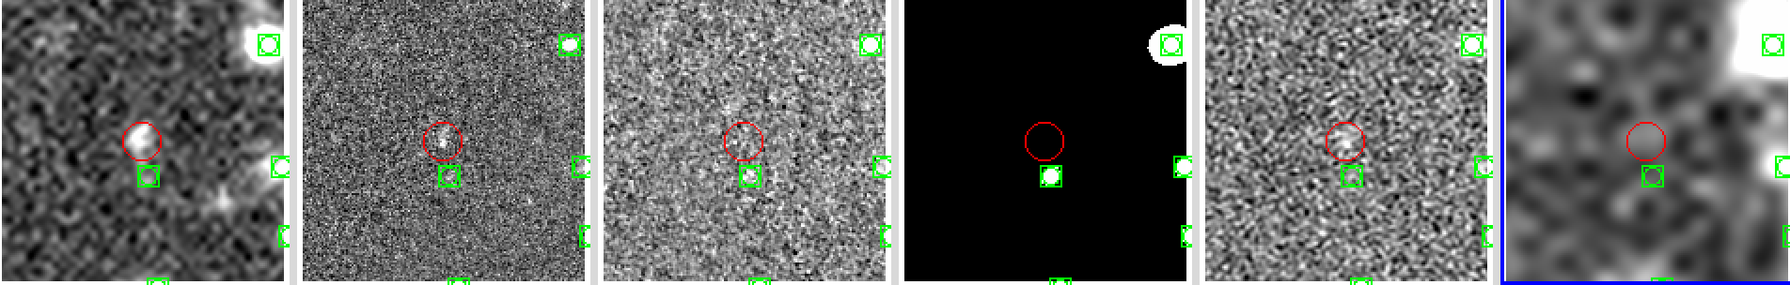
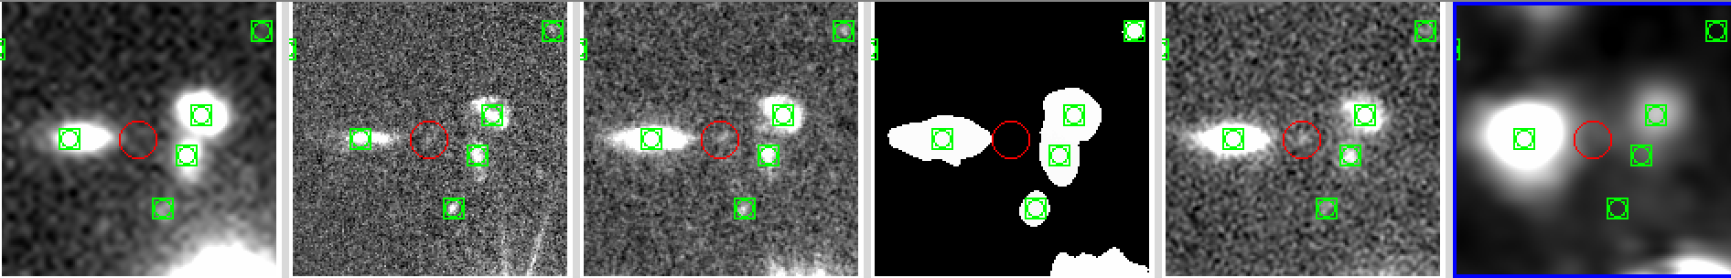
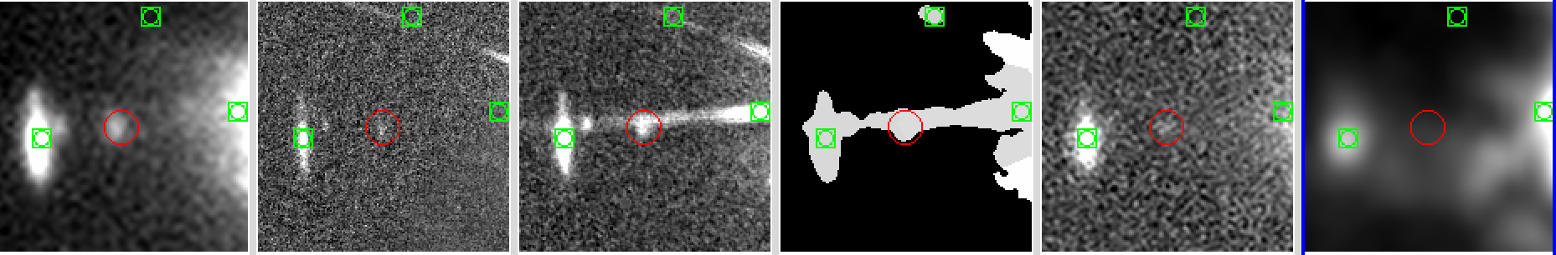
K-selected sources
R I H H_seg K CH1
2013
10754
1202

Slide 7
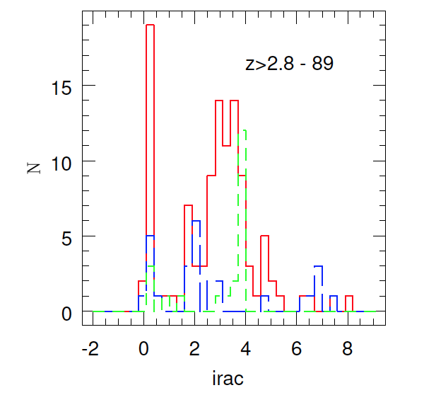
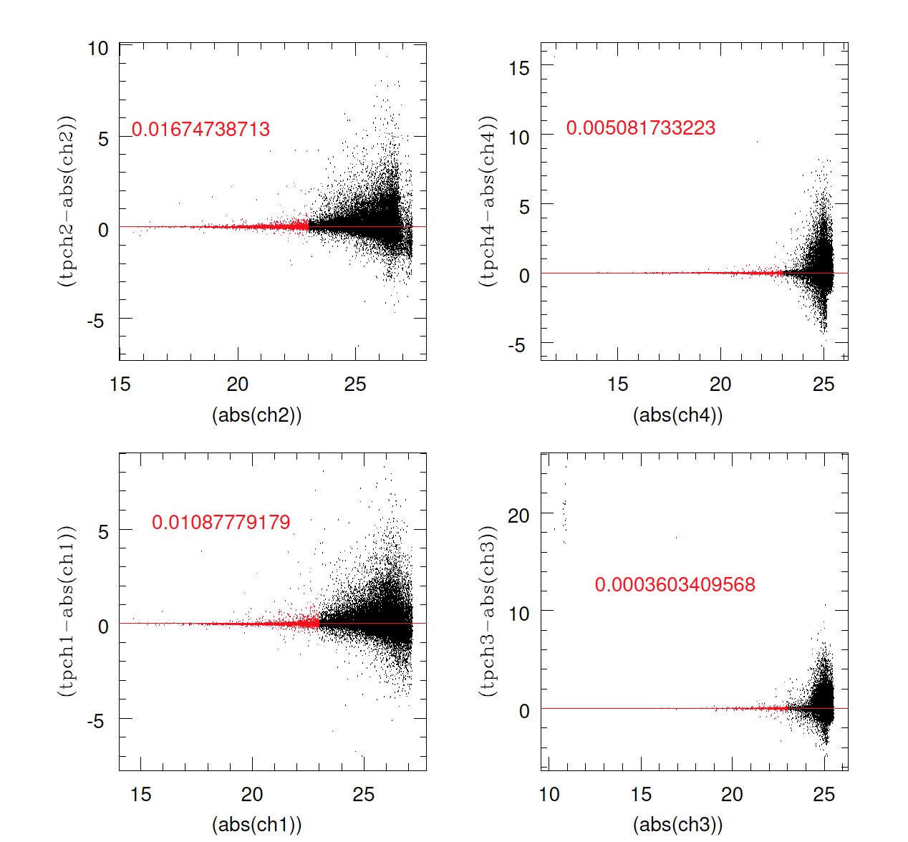
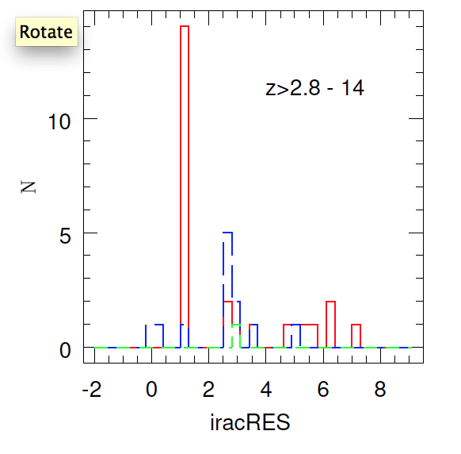
K-selected sources

Slide 8
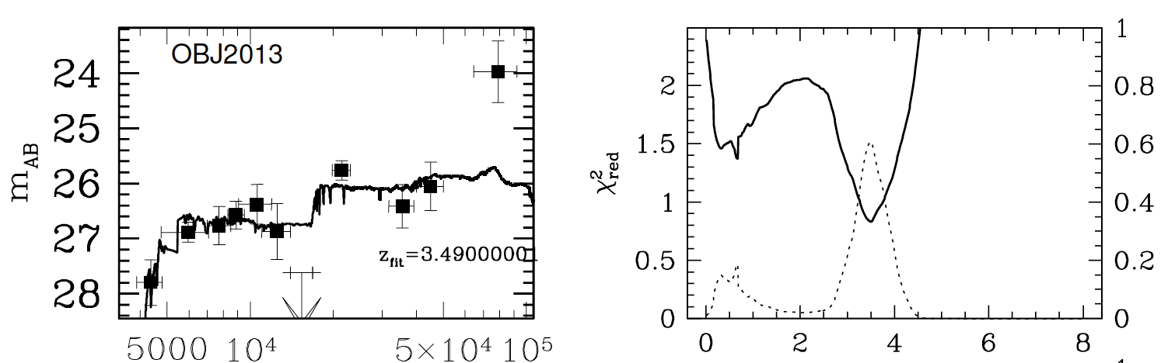
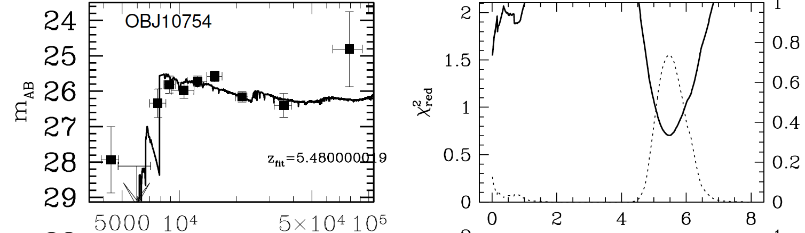
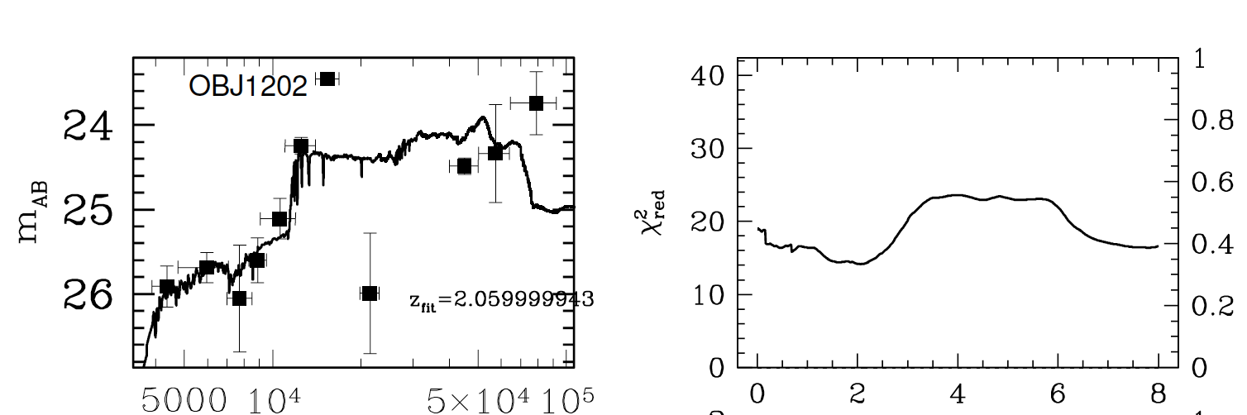
K-selected sources

Slide 9
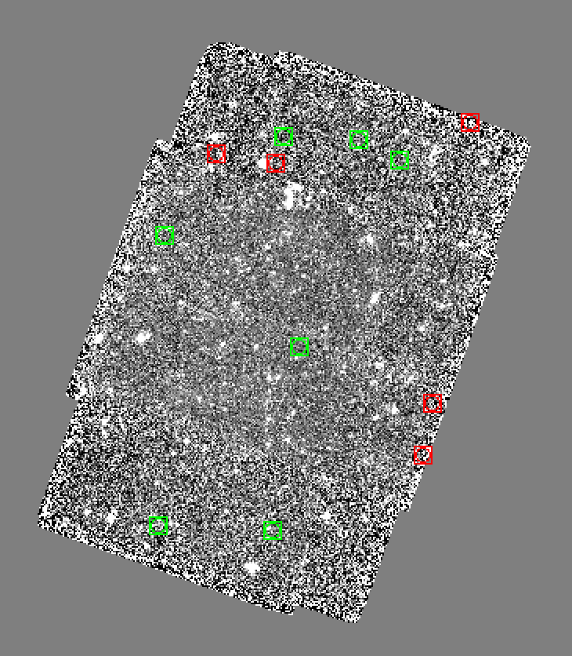
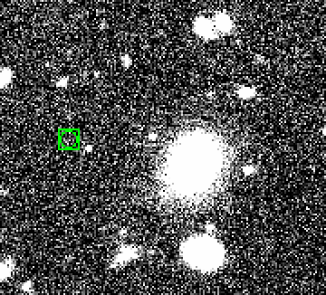
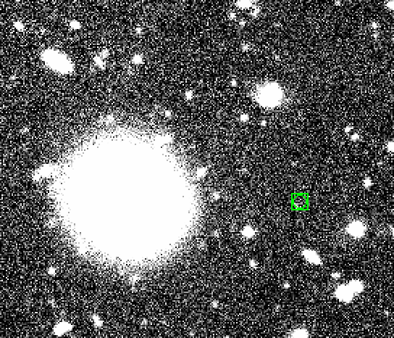
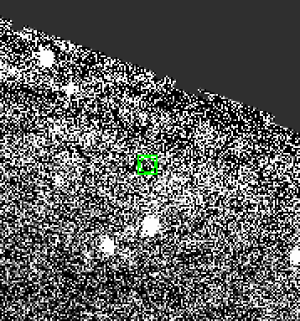
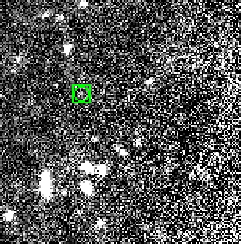
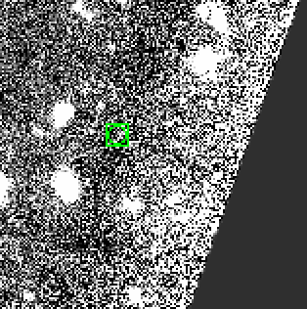
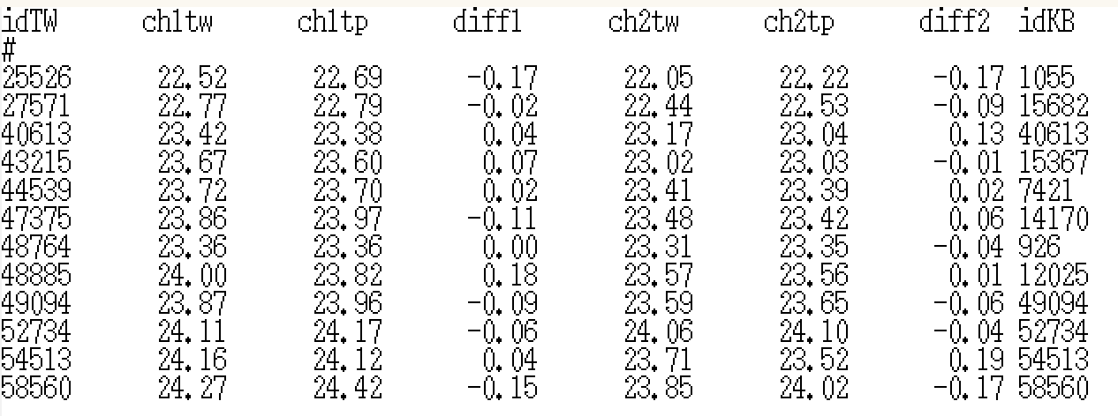
K-selected sources

Slide 10
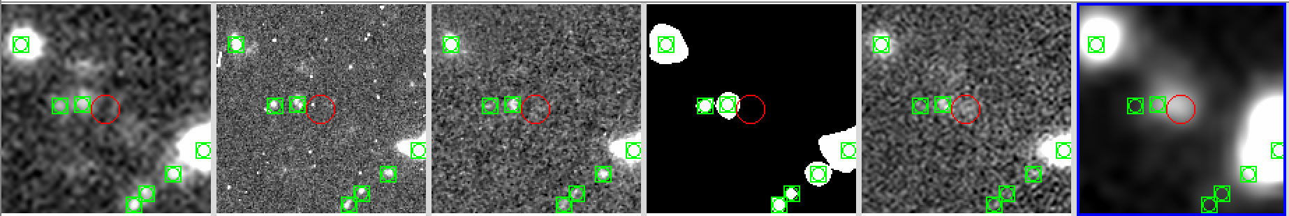
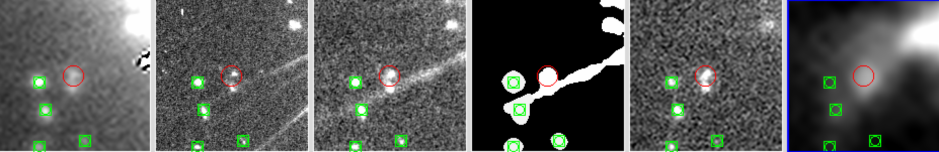
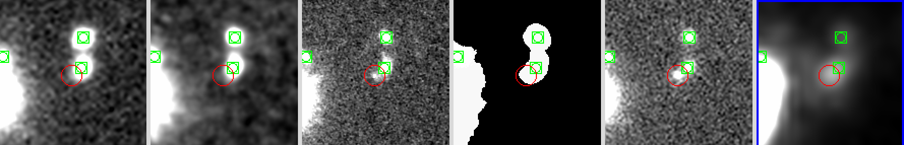
K-selected sources
Sources with IRAC flux in our K selected sample
There are 21 sources with SN_CH1>=5 and 24 with 1<SN_CH1<5
2545
7693
16306

Slide 11
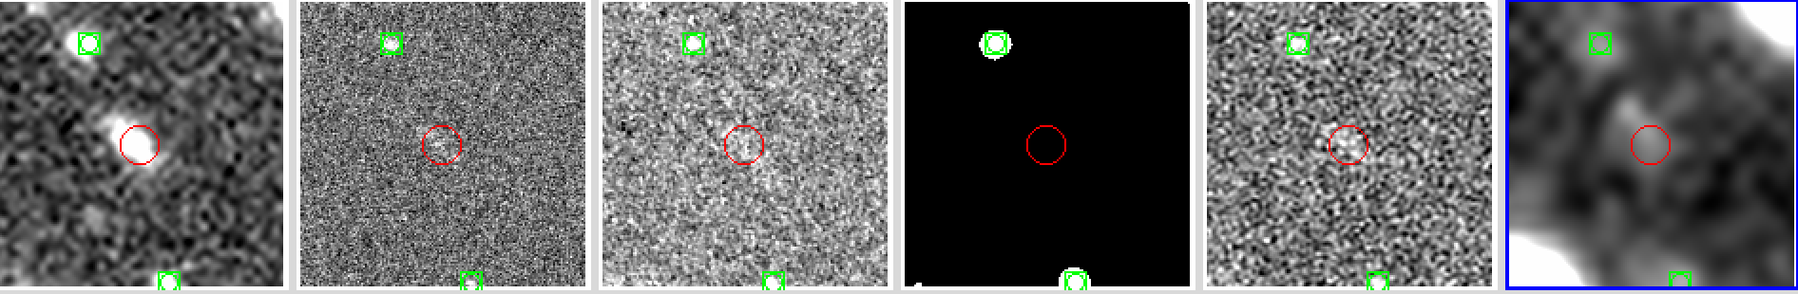
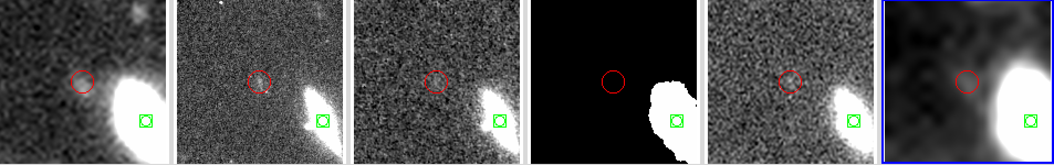
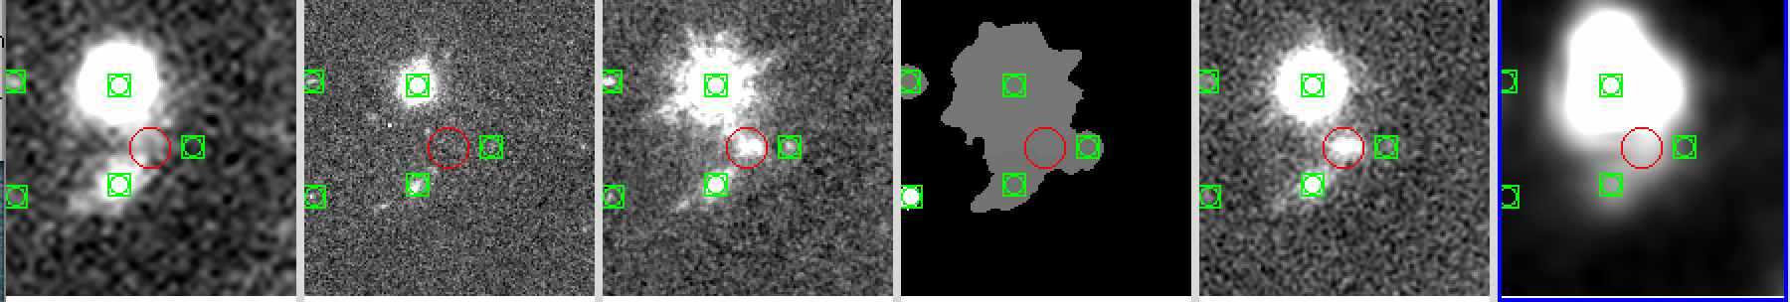
K-selected sources
Sources with IRAC flux in our K selected sample
There are 21 sources with SN_CH1>=5 and 24 with 1<SN_CH1<5
1944
2878
3884

Slide 12
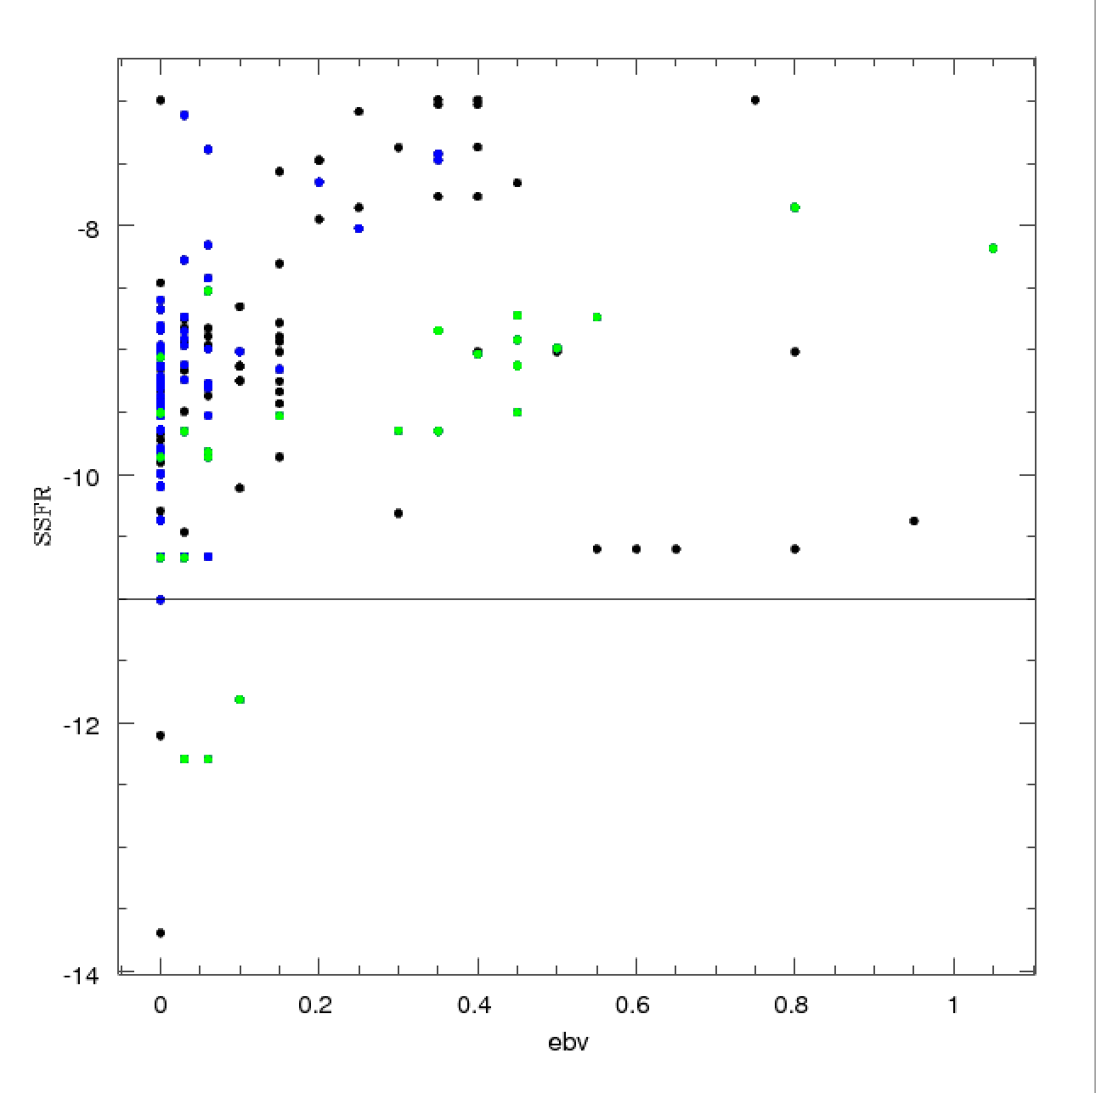

K-selected sources
To conclude:
Identify interesting sources based on physical parameters as obtained from Zphot.
Thank you!

