Slide 1
Getsources and Herschel selected high-z dusty galaxies
Xinwen Shu
CEA Herschel group, Saclay
Astrodeep meeting, Jan 27, CEA

Slide 2
~14 min talk
Getsources introduction (3 min)
Application to simulated Herschel images (4min)
Select candidates of high-z dusty galaxies (with the simulations) (5 min)
Summary (2 min)

Slide 3
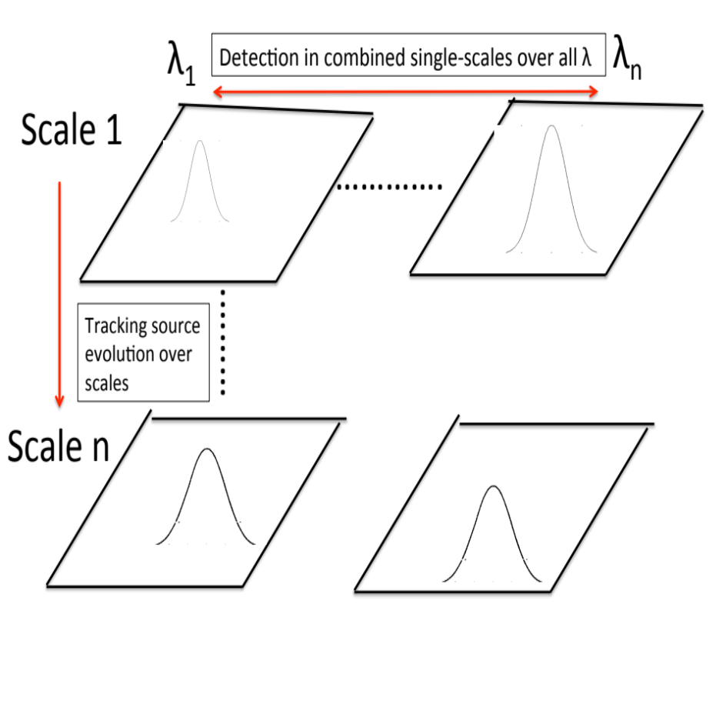
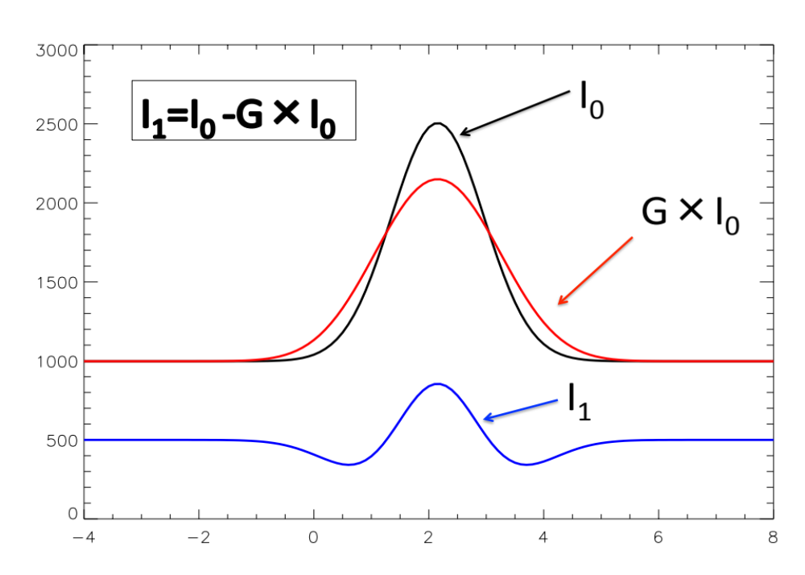
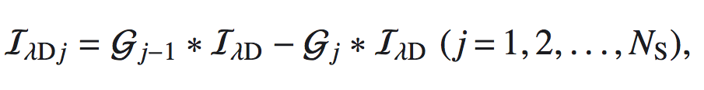
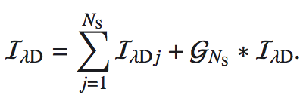
Getsources decomposes observed images in spatial scales
IλD is observed image and G is smoothing Gaussian beams, and
subtracting convolved images from
one another
IλDj are “single-scale” decompositions
IλD
IλDj
Men’shchikov et al. 2012, A&A, 542, 81

Slide 4
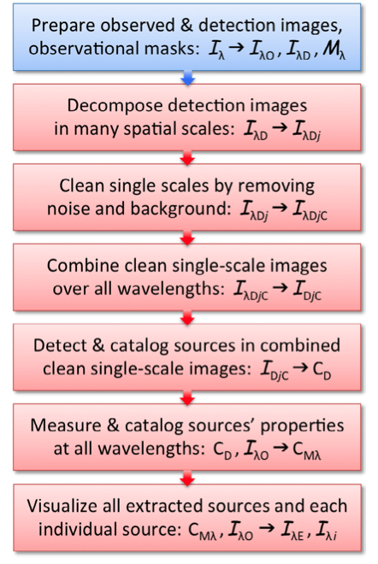

Slide 5
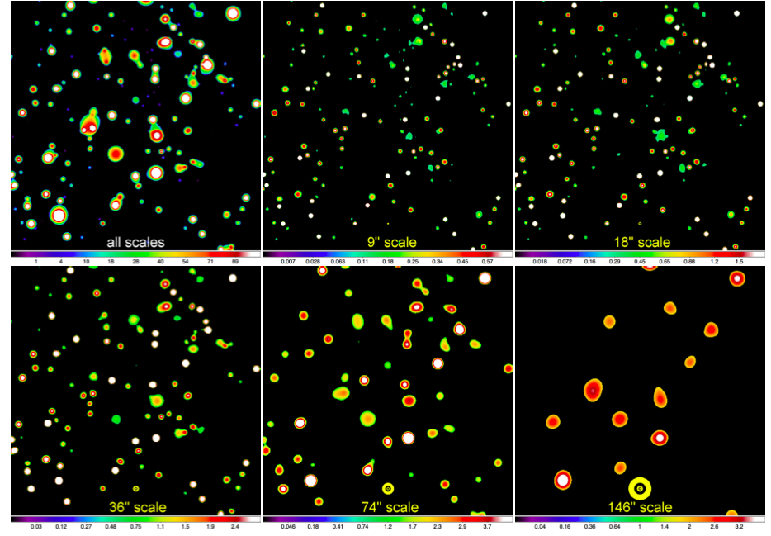
Example of single-scale decomposition of a simulated star-forming region at 350um (M+12), and removal of noise and background (can better separate sources from bg and noise),

Slide 6
Example of single-scale decomposition of a simulated star-forming region at 350um (M+12), and removal of noise and background (sources evolve from small to large scales^{),}

Slide 7
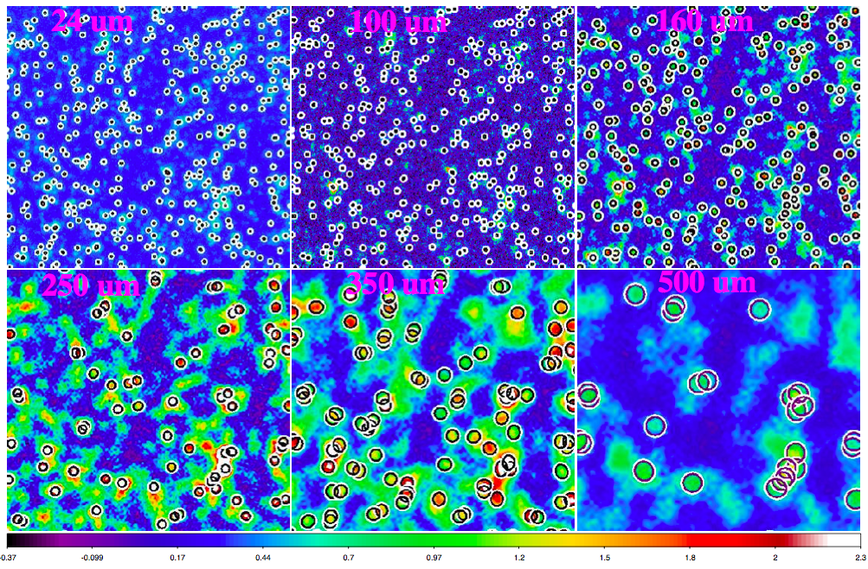
Application to the simulated Herschel images (GOODS-N)

Slide 8
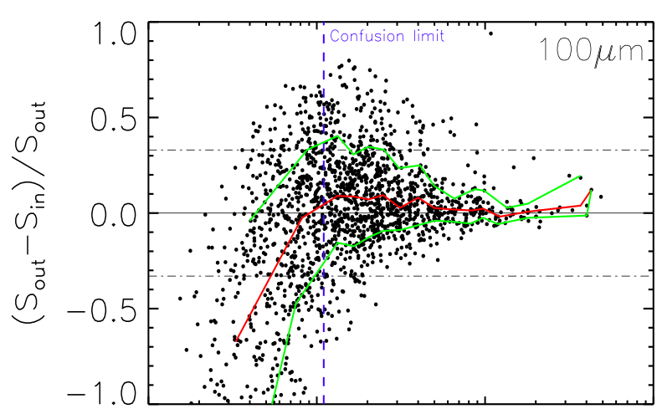
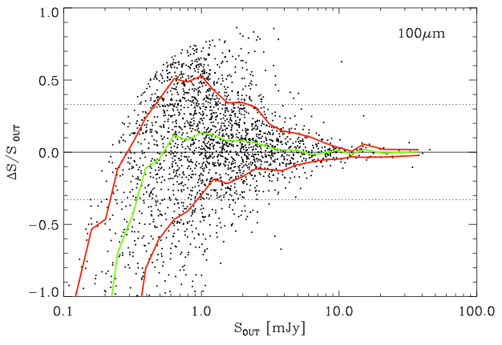
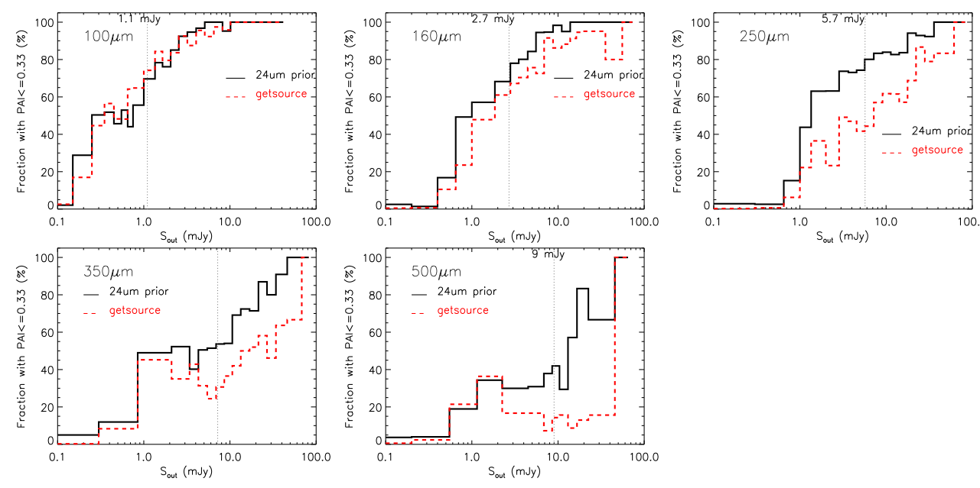
getsources
Comparison between getsources and
24um prior technique at PACS 100um
Similar fraction of src detected with ΔS/S<0.33 as a function of Sout
Ex: >70% of the sources are detected with a photometric accuracy better than 33% at >1.1 mJy
24um prior

Slide 9
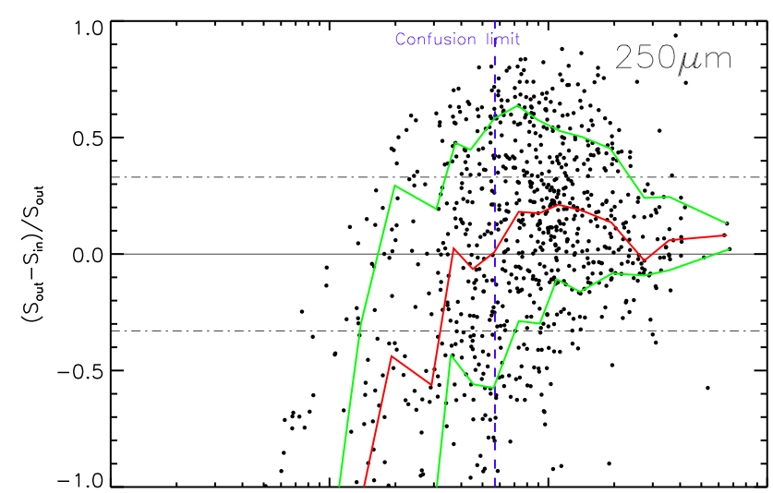
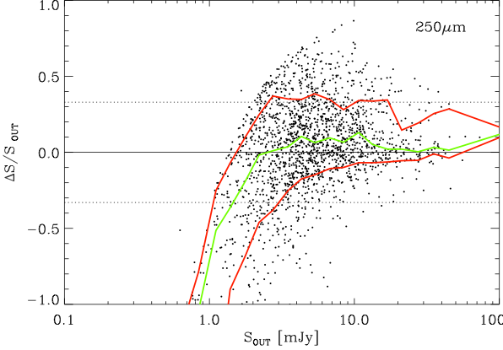
However, getsources loses completeness at longer Herschel bands
Ex: >70% of the sources are detected with ΔS/S<0.33 above 5.7 mJy at SPIRE 250um for the 24um prior technique
Vs. >40% of the sources are detected by getsources
getsources
Getsources
24um prior

Slide 10
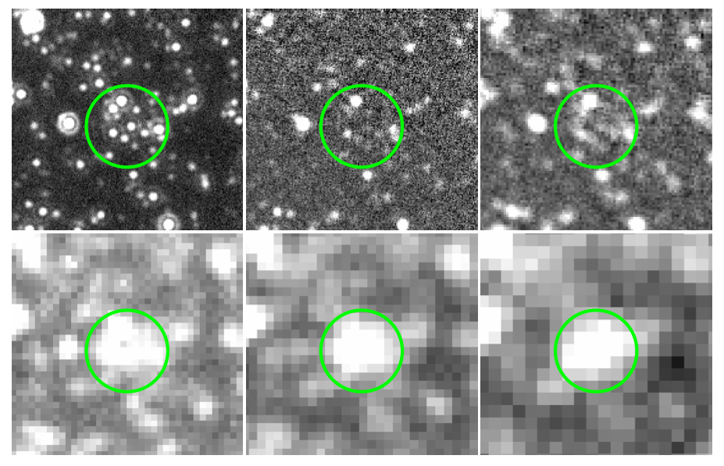
FWHM= 5.7” 6.7" 11" 18.1" 24.9" 36.9"
λ (μm)= 24 100 160 250 350 500
24um
100um
160um
Blending and
Confusion limited
250um
350um
500um

Slide 11
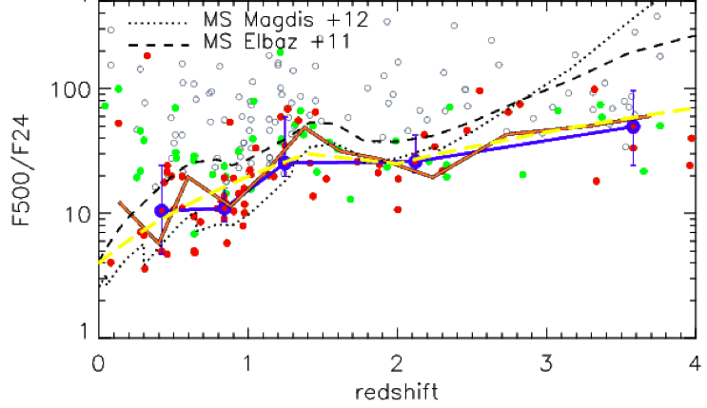
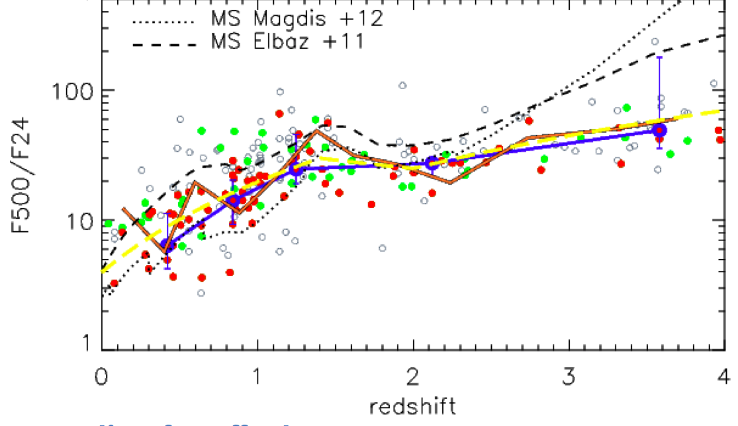
Blending can magnify the flux in 500um
Leiton et al. in prep.

Slide 12
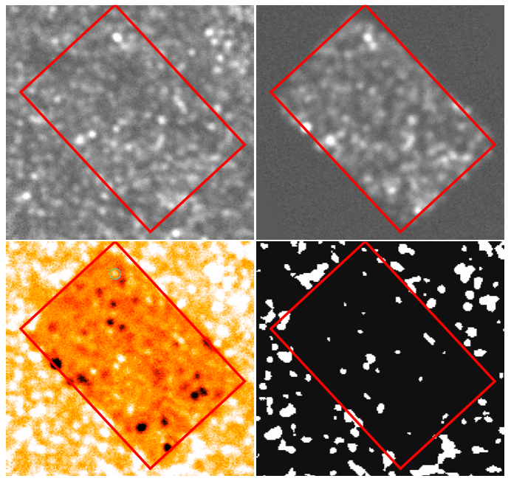
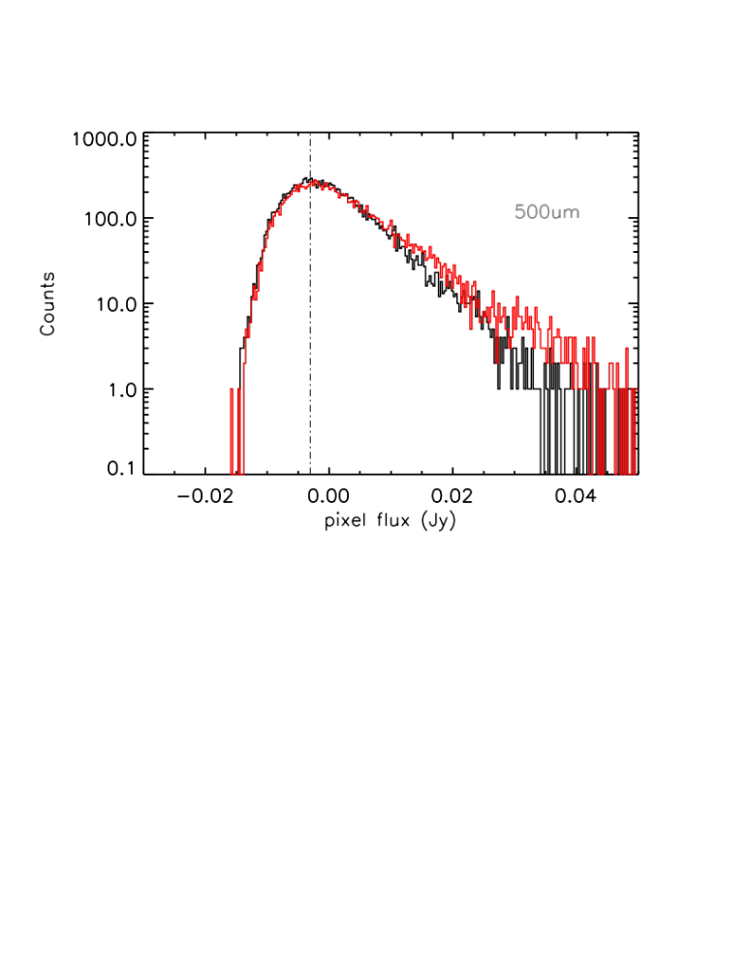
Real
500um
Simulated
500um
Segmentation
Map
Comparison between the real 500um image and simulated image for GOODS-NORTH field
Red box: FOV of 24um
P(D) plot:
Black: real pixel flux distribution;
Red: simulated pixel flux distribution

Slide 13
Real
500um
Simulated
500um
Difference
Map
Segmentation
Map
GN20, z=4.05

Slide 14
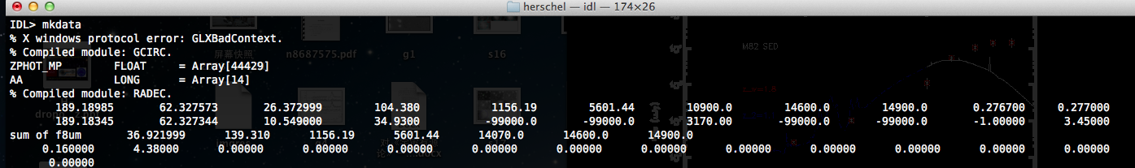
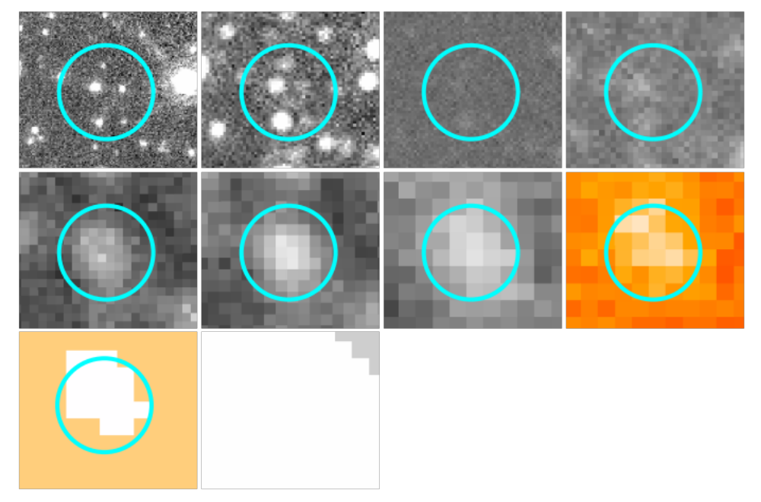
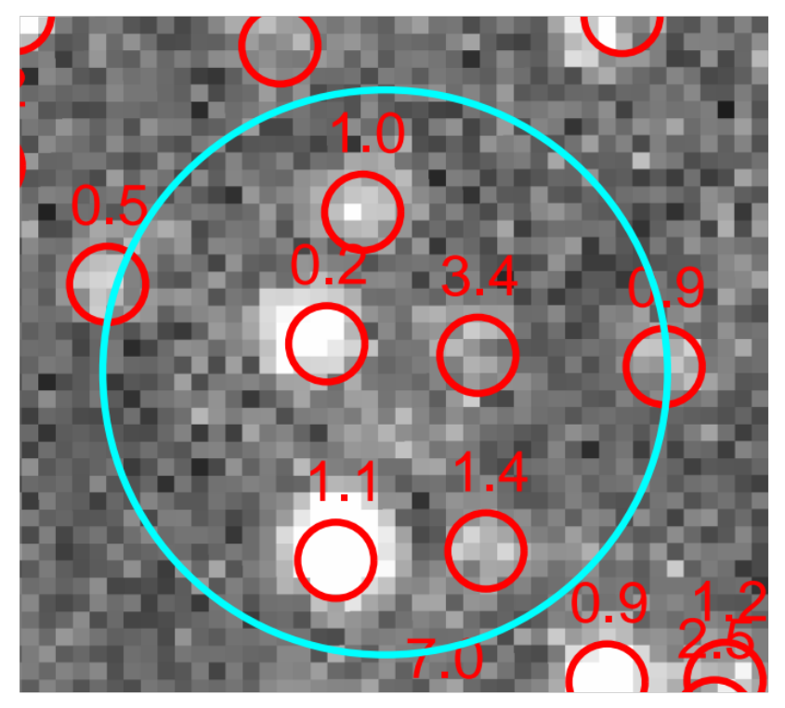
FWHM= 5.7” 6.7" 11" 18.1" 24.9" 36.9"
λ (μm)= 24 100 160 250 350 500
A high-z source can be blended with a very close low-z neib., making its flux hard to measure
24um
500 um
z
8um
24um
100um
160um
250um
350um
500um
D map
S map

Slide 15
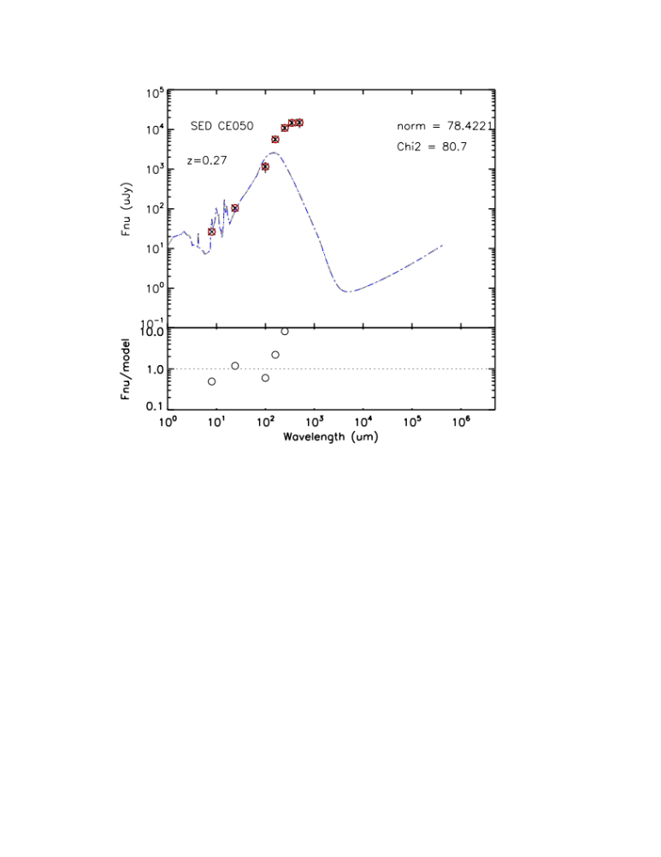
24um
500 um
z

Slide 16
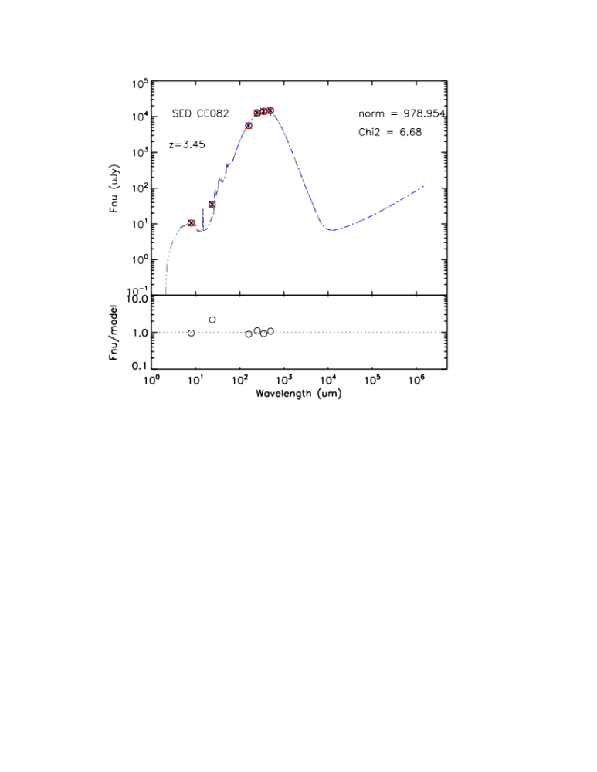
24um
500 um
z
>250um
“Spectral” deconfusion:
<=250um, using the measured flux, as the sources are weakly confused
2. >250um, i.e., SPIRE 350 and 500 um, using the total flux within the beam
3. Iteratively subtract the flux in SPIRE 350 and 500um from low-z sources (based on z and best-fit templates), yielding measurable SPIRE fluxes for high-z candidates

Slide 17
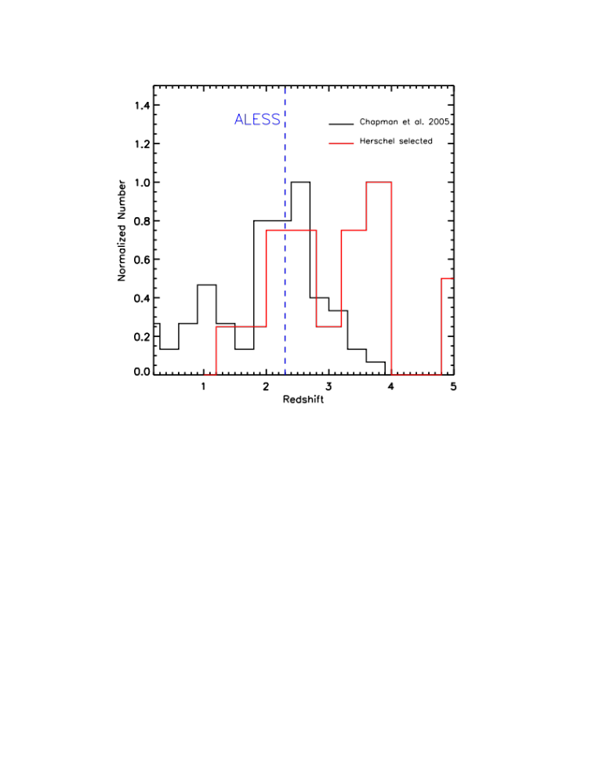
19/21 sources detected (>2sigma) in the difference map are likely associated to source at z>2, but need more further detailed investigations.

Slide 18
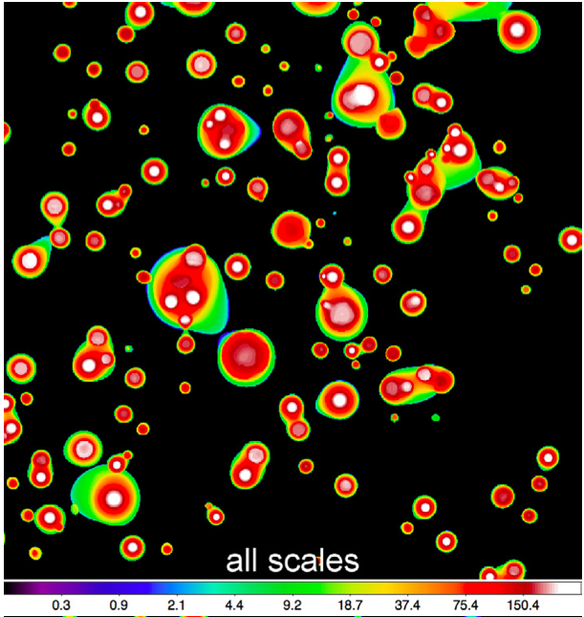
Summary:
“Difference” map (with simulations) can uncover potential candidates at high-z by reducing the confusion in longer SPIRE bands. We are applying the method to four CANDELS fields.
By analyzing fine spatial decompositions, getsources can detect and measure sources effectively in PACS, but loses completeness at SPIRE bands
getsources can perform “blind” source extractions, and is complementary to prior-based techniques.
Other applications of getsources? E.g., cluster fields (HFFs)?
Thanks!
Notes:
By filtering out contributions of sources on irrelevant spatial scales, getsources can be applied to detect faint sources over larger structures (e.g., cluster fields)

Slide 19
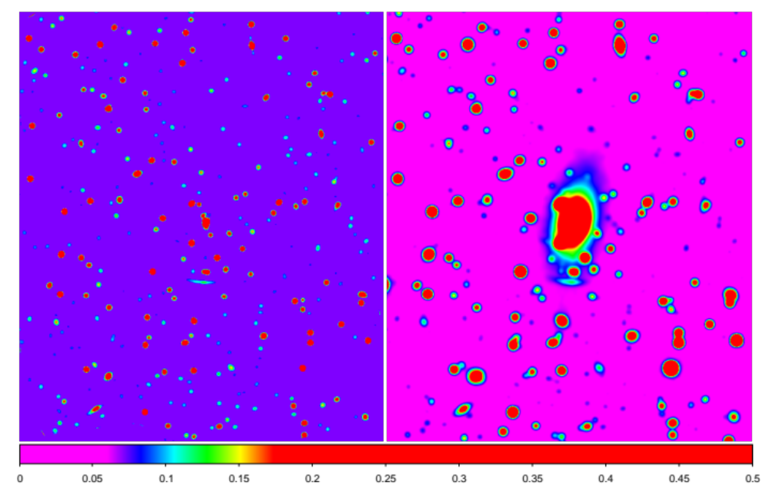
Getsources on the cluster M0429, F160W band

