Slide 1
Herschel Deconfusion
Harry Ferguson
Mohammand Safarzadeh

Slide 2
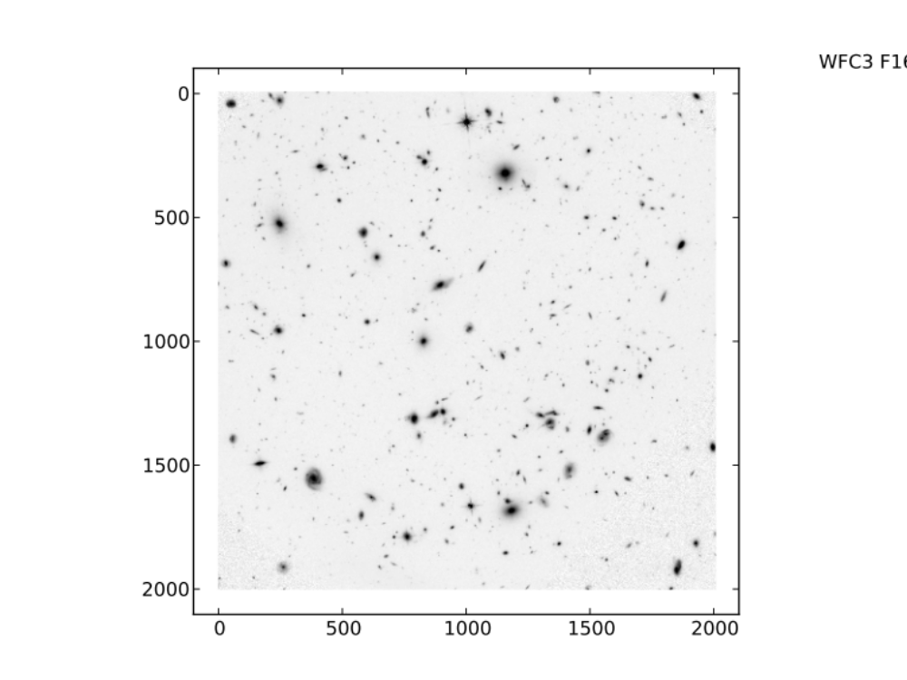
WFC3 F160W

Slide 3
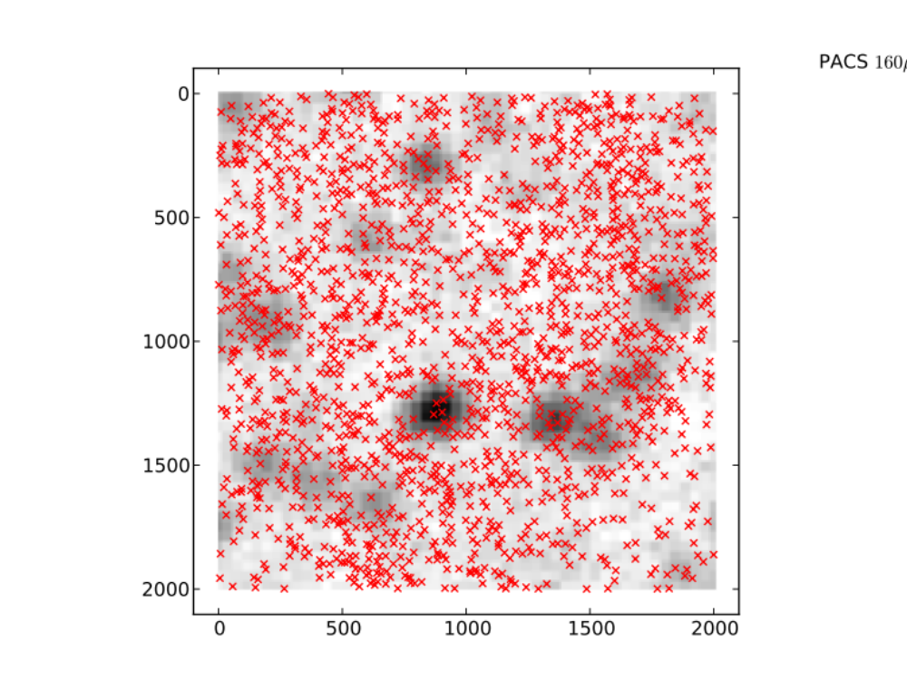
PACS 160

Slide 4
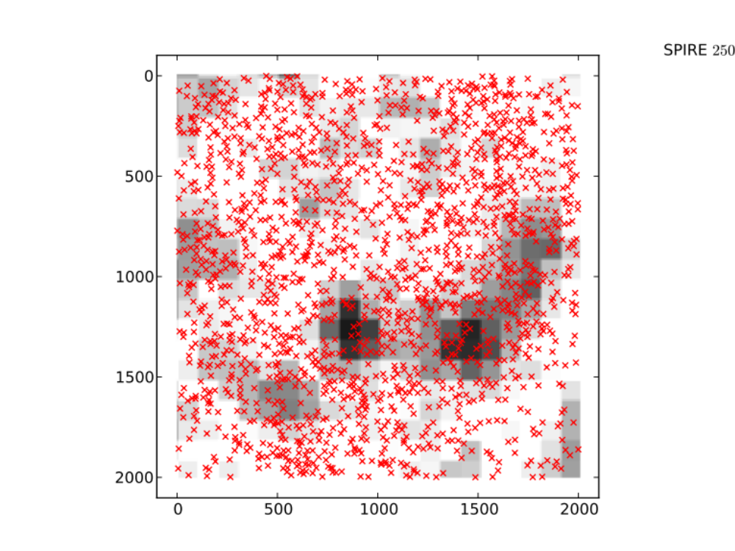
SPIRE 250

Slide 5
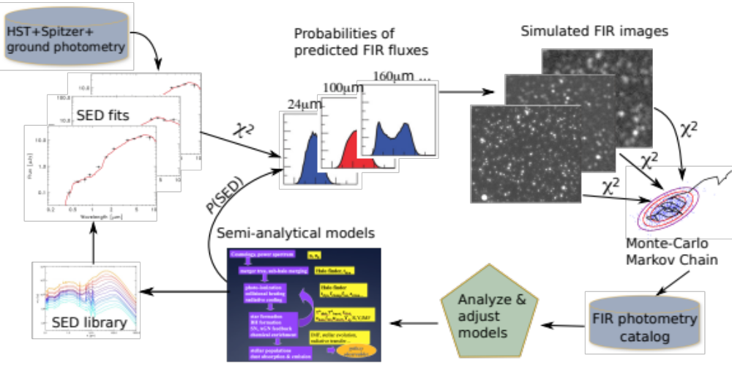
Bayesian fitting procedure

Slide 6
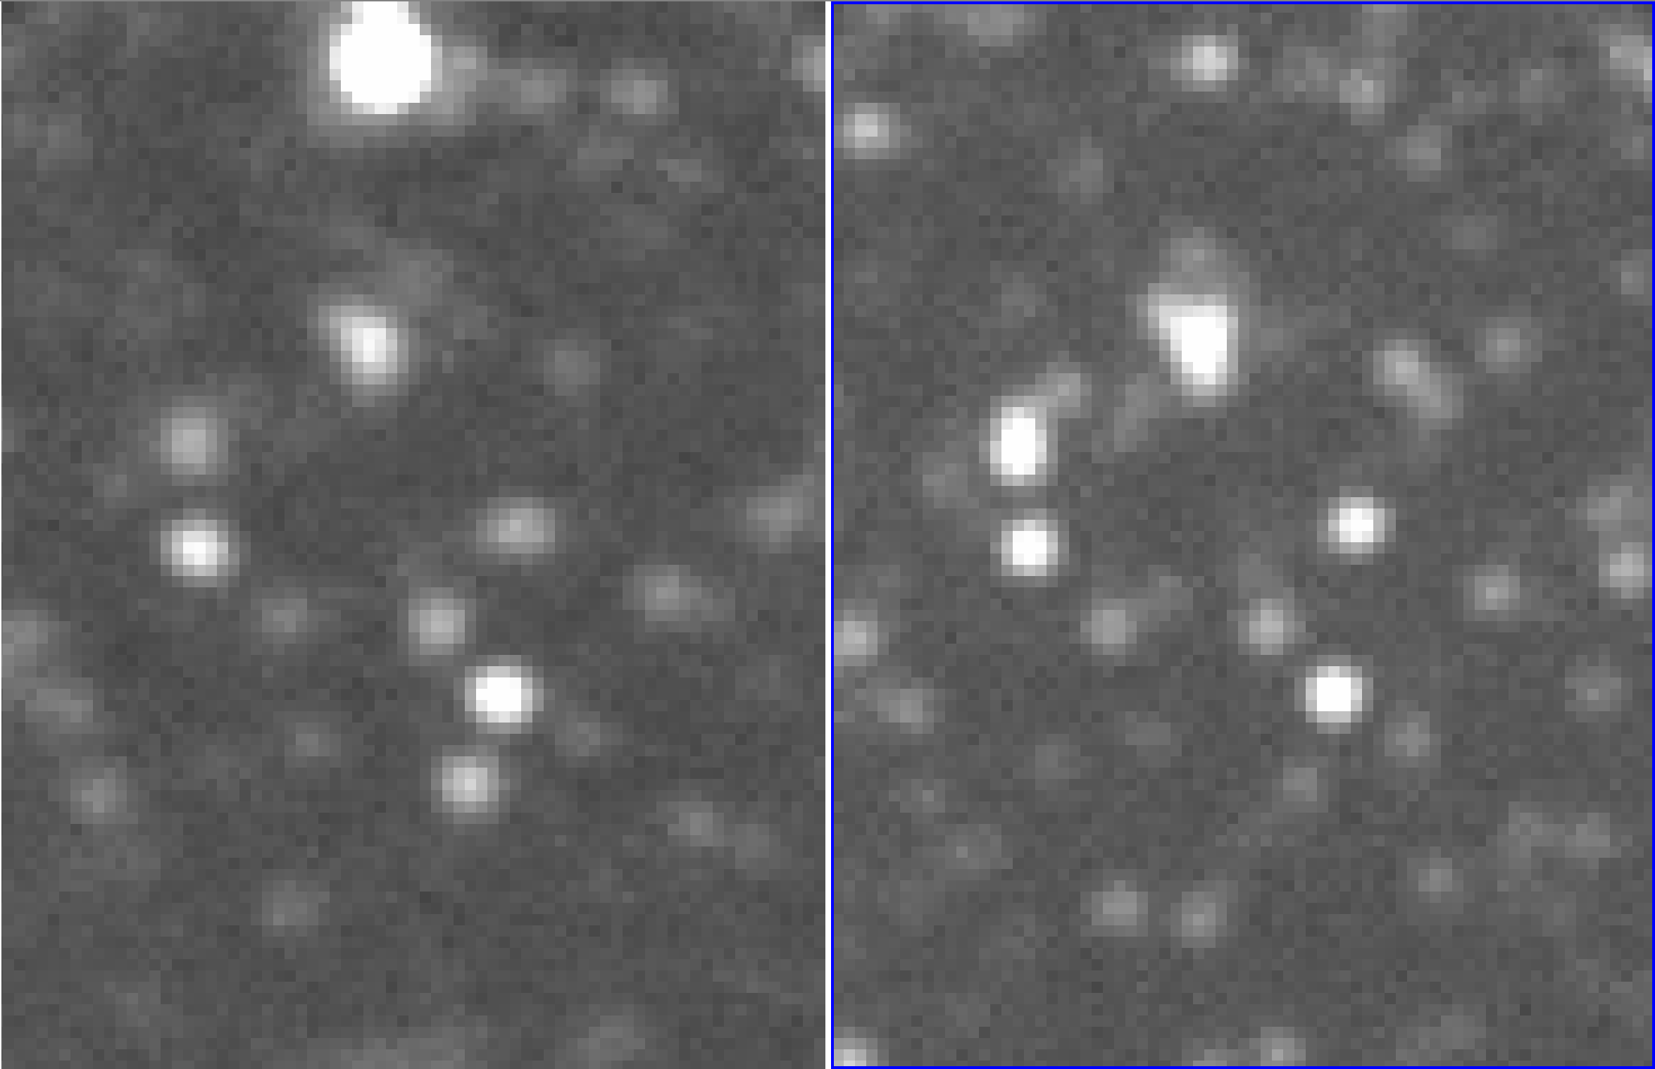
Current model prediction without fitting Herschel

